Slide 1
Department of the Army
Retirement Planning
Informational Briefing
JBSA Fort Sam Houston, TX
Army Retirement Services Office
13 July 2023
Notes:
Army Policy, AR 600-8-7, Retirement Services Program stipulates that Soldiers attend a Retirement Planning Seminar. It is recommended that Soldiers attend such seminar 12 months before Terminal Leave and Administrative Absence begins. We have found that it is helpful for Soldiers to attend more than one Retirement Planning Seminar because of the amount of technical information it contains. Spouses are highly encouraged to attend the Retirement Planning Seminar.

Slide 2
Mandatory Retirement Planning Seminar topics
RSO Program
Retired Pay & Taxes
Cost of Living Adjustments
Terminal Leave & Transition Administrative Absence*
Uniformed Services Former Spouses' Protection Act
SGLI VGLI
Shipment of Household Goods
Post-Service Employment and Ethics
Space-A Travel
ID Cards
Combat-Related Special Compensation (CRSC)
Concurrent Retirement and Disability Pay (CRDP)
Retiree Mobilization
Survivor Benefit Plan (SBP) (Separate Brief) https://soldierforlife.army.mil/retirement/survivor-benefit-plan
MyArmyBenefits
Visit websites for complete information on TRICARE, VA benefits, and Social Security
* Formerly known as Transition Leave and
Permissive TDY (PTDY)
The Army Transition Assistance Program
is a separate program for all Soldiers leaving the Army
Notes:
SBP: https://soldierforlife.army.mil/Retirement/survivor-benefit-plan
MyArmyBenefits: https://myarmybenefits.us.army.mil/
TRICARE: https://www.tricare.mil
VETERANS BENEFITS: https://www.va.gov
SOCIAL SECURITY: https://www.ssa.gov

Slide 3

Purpose
To provide an overview of the planning needed to prepare for retirement.
NOTE: This briefing is not designed to replace the Army Retirement Planning Seminar provided by Retirement Services Officers!

Slide 4
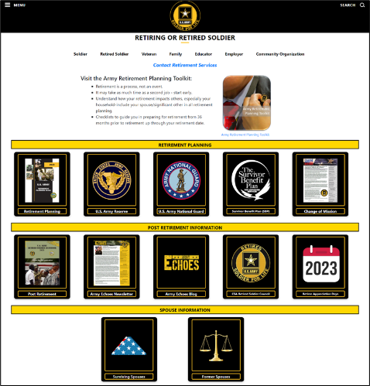
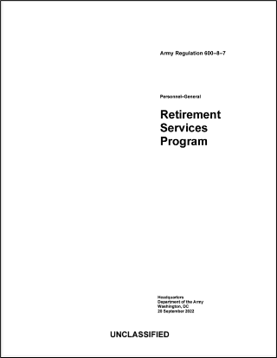

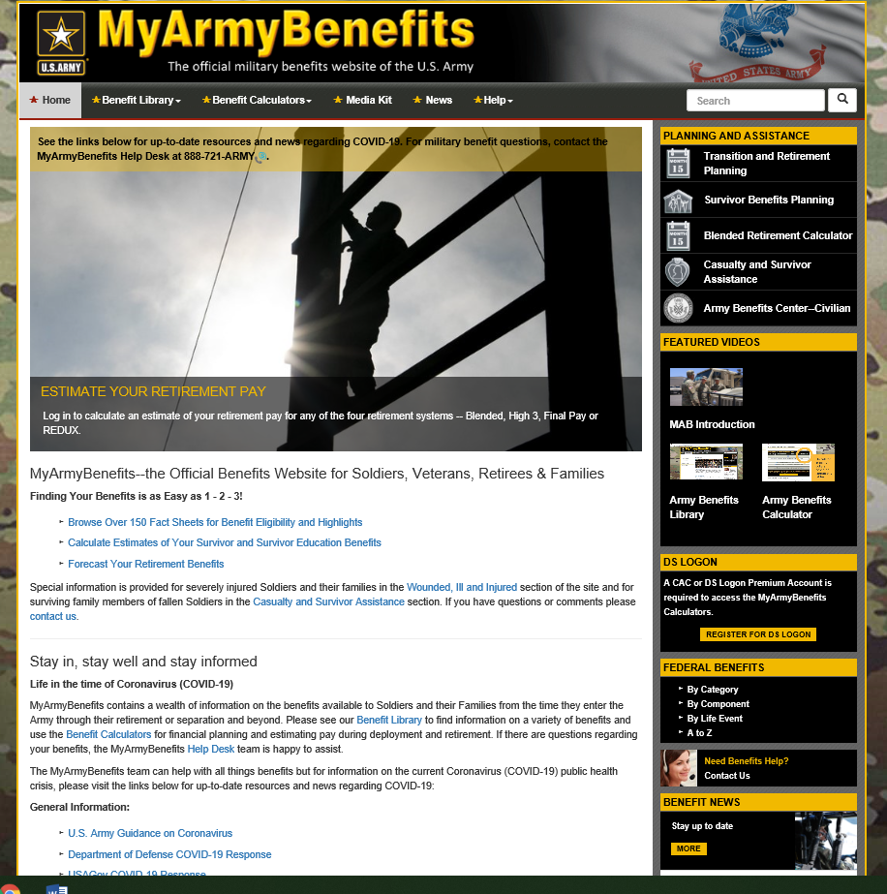
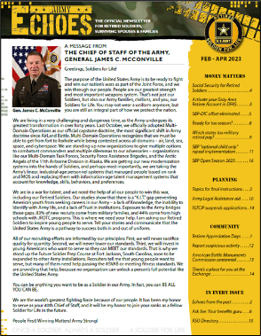
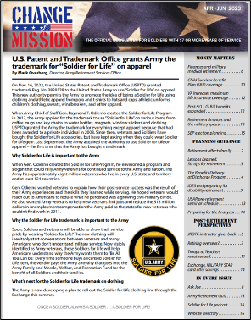

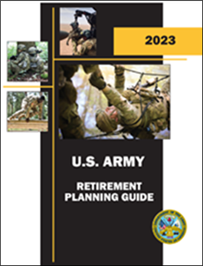


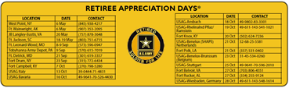

Army Retirement Services
Retirement is a process,
not an event!
Your mission has changed,
but your duty has not!
Retirement Planning Policy
Post-Retirement Policy
The Blog
Regular Army | ARNG | USAR |  | Retired Soldiers | Surviving Spouses
93,098 | 45,096 | 39,217 |  | 1,015,433 | 249,054
FY22: 30,874 Soldiers retired
FY21: $22.9B in retired and annuitant pay
Notes:
This slide summarizes Army Retirement Services policy and the population that policy supports every day. The numbers under retirement planning policy reflect all Soldiers in all three compos that have 17 or more years of service towards retirement.
The slide represents the populations the retirement services program supports. Data is provided by the Defense Manpower Data Center and the Defense Finance and Accounting Service.
The slide aggregates supported populations into two categories that reflect the major policy areas within AR 600-8-7, Army Retirement Services.
AR 600-8-7, includes Regular Army, United States Army Reserve and Army National Guard retirement services programs in an effort to provide all Soldiers with a common level of support during and after their final transition from the Army.
Our key message is that “Retirement is a process, not an event!”

Slide 5


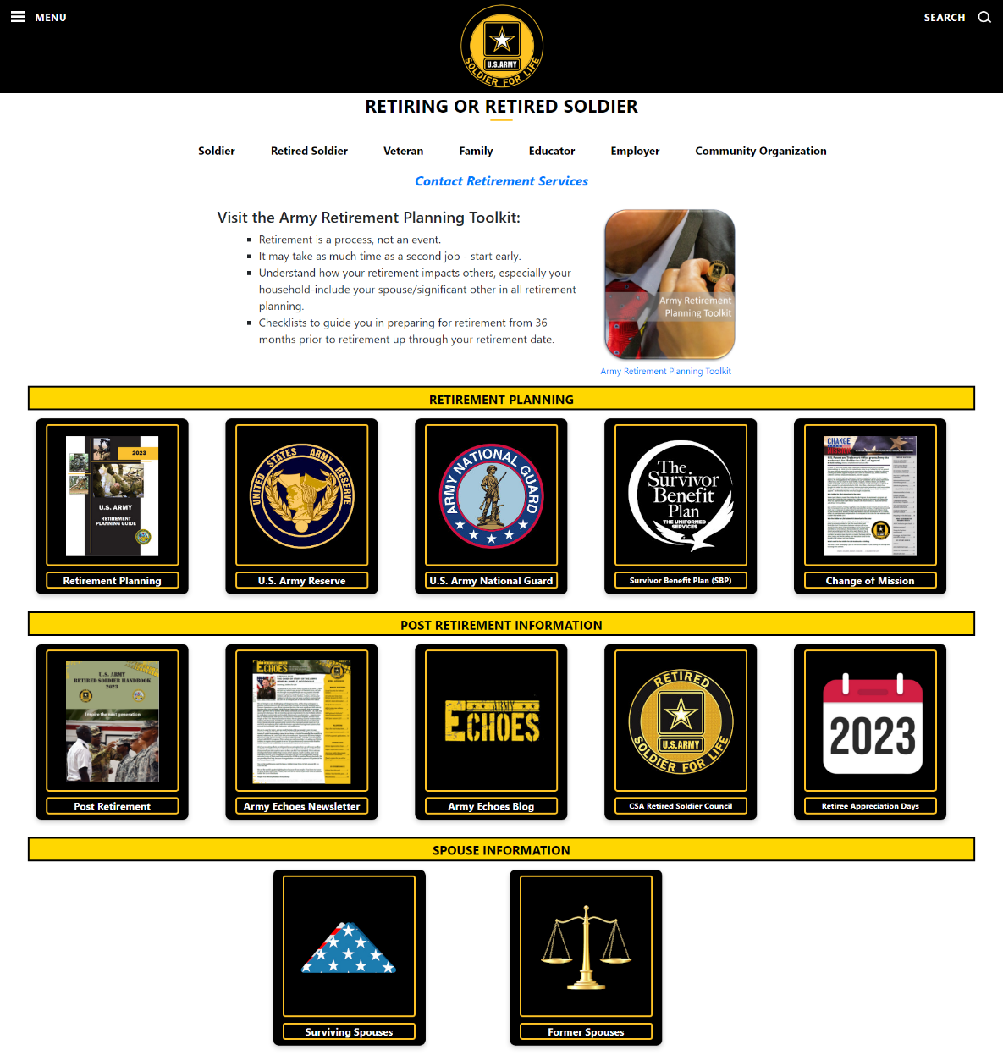
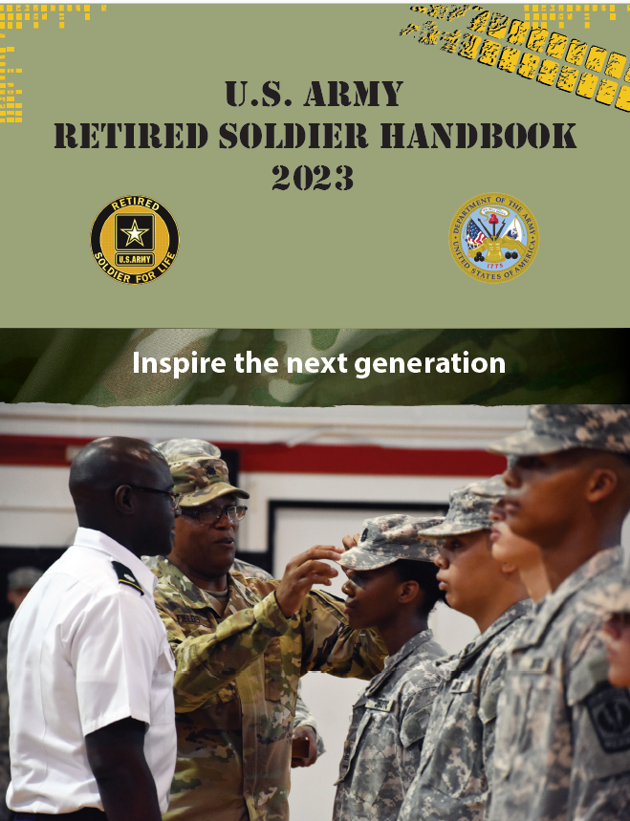

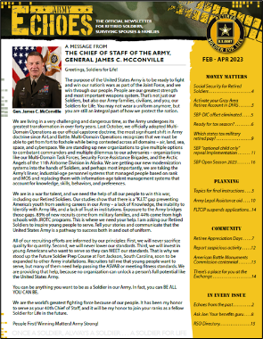

The Army Retirement Services Website
https://soldierforlife.army.mil/Retirement
Army Retirement Planning Toolkit
Former Spouses

Slide 6
Throughout Your Retirement Planning
  Gather and study information needed to make critical retirement decisions
  Discuss the information with your Family
  Check out the Retirement Planning Toolkit available at https://soldierforlife.army.mil/Retirement-Toolkit/The-Basics for checklists and timelines to assist you throughout your retirement planning process

Slide 7
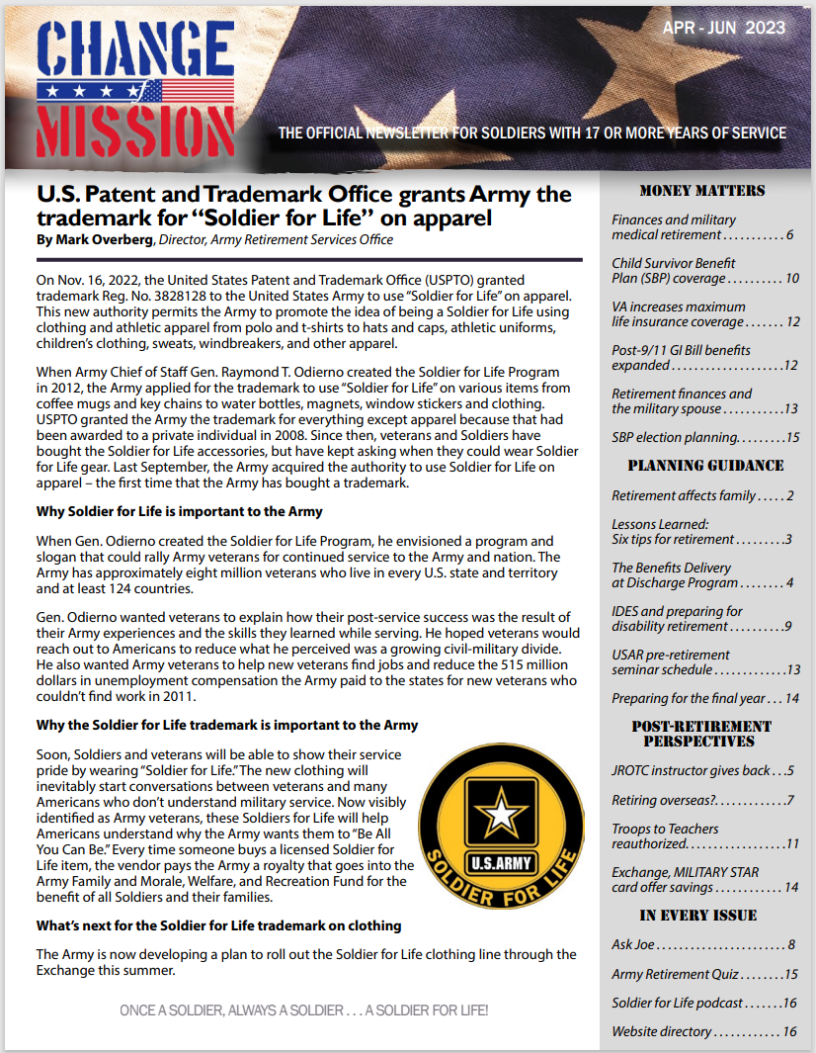
Change of Mission
U.S. Army’s official retirement planning
newsletter for Soldiers in all three components
with 17+ years of service
Published via myPay SmartDoc in
Jan, Apr, Jul and Oct
Sent to 186K Soldiers quarterly. If you didn’t
receive it, check your email address in myPay
Available at https://soldierforlife.army.mil/retirement/change-of-mission

Slide 8
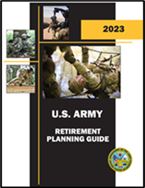


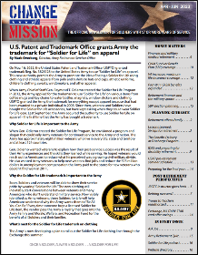


The Retirement Planning Timeline
2023 U.S. Army
Retirement
Planning Guide
36 months
Gather resources
Retire where?
Retire when?
Determine service providers
Create major decision timeline
Plan to work? School?
Consider credentialing & internships
Start transition savings fund
24-18 months
Apply for retirement (between 12 and 24 months)*
PCS move before retirement?
Required service obligations?
Retired pay estimate
Attend Army TAP
Attend Mandatory Retirement Planning Seminar
12-6 months
Apply for retirement (between 9 and 12 months)
Pre-separation transition checklist
Start active job search
- Finalize transition administrative absence & terminal
leave plan
- Interview/post-retirement wardrobe purchases
18-12 months
Medical/dental care catch up
College applications?
Start employment networking
SBP and life insurance
Investigate healthcare options
6 months
to 1 month
Retirement physical
Survivor Benefit Plan election
Change myPay email
Schedule final move
House-hunting
BRS lump sum application
Terminal leave & Administrative Absence
Hand over job responsibilities
Apply for VA disability compensation
Retirement month
(if not already done)
Retirement ceremony
Out-processing/DD 214
Get medical records
HHG move
Will/POA update
0-6 months after
New ID cards
Apply for TRICARE
New job starts
VGLI?
CRSC?
Priority tasks indicated in red
*under pilot program allowing requests for voluntary AFS retirement up to 24 months out.
Notes:
For detailed information in regard to this timeline, refer to the U.S. Army Retirement Planning Guide located at https://soldierforlife.army.mil/Retirement/retirement-planning
The Army began a pilot program in 2023 that allows Soldiers in the Regular Army (RA), the Army National Guard (ARNG)/Army National Guard of the United States (ARNGUS) and United States Army Reserve (USAR) serving on Active Guard Reserve (AGR) tours or on active service orders, to submit their request to retire from active duty between 12 and 24 months before their retirement date. The expiration date for the exception to policy goes through 31 March 2024, and applies to retirements that occur on or after 1 April 2024.

Slide 9
180-Day Restriction on Hiring Retired Military
How does the 180-Day Restriction on Hiring Retired Military Impact Me?
The Department of Defense (DoD) has restrictions on hiring military members for DoD Federal civilian positions within 180 days of retirement. This includes and impacts military members on transition leave.
Military retirees may not be appointed within 180 days after the effective date of military retirement as an appropriated fund (GS), or non-appropriated fund (NAF) civilian employee unless the position is covered by a special salary.
The 180-day restriction is in place unless the hiring official requests and receives an approved waiver.
Notes:
The 180 day restriction is in law under Title 5 United States Code Section 3326 as follows:
§3326. Appointments of retired members of the armed forces to positions in the Department of Defense
(a) For the purpose of this section, "member" and "Secretary concerned" have the meanings given them by section 101 of title 37.
(b) A retired member of the armed forces may be appointed to a position in the civil service in or under the Department of Defense (including a nonappropriated fund instrumentality under the jurisdiction of the armed forces) during the period of 180 days immediately after his retirement only if-
(1) the proposed appointment is authorized by the Secretary concerned or his designee for the purpose, and, if the position is in the competitive service, after approval by the Office of Personnel Management; or
(2) the minimum rate of basic pay for the position has been increased under section 5305 of this title.
(c) A request by appropriate authority for the authorization, or the authorization and approval, as the case may be, required by subsection (b)(1) of this section shall be accompanied by a statement which shows the actions taken to assure that-
(1) full consideration, in accordance with placement and promotion procedures of the department concerned, was given to eligible career employees;
(2) when selection is by other than certification from an established civil service register, the vacancy has been publicized to give interested candidates an opportunity to apply;
(3) qualification requirements for the position have not been written in a manner designed to give advantage to the retired member; and
(4) the position has not been held open pending the retirement of the retired member.

Slide 10

DoD SkillBridge Program and
Army Career Skills Program
The DoD SkillBridge Program:
Provides an opportunity for service members to gain valuable civilian work experience through specific industry training, apprenticeships, or internships during the last 180 days of service. Service members participating in SkillBridge receive their military compensation and benefits, and industry partners provide the training and work experience. https://skillbridge.osd.mil/
The Army Career Skills Program (CSP):
Affords transitioning service members the opportunity to participate in employment skills training (EST), on-the-job training (OJT), pre-apprenticeships and internships with a high probability of employment in high-demand and highly-skills jobs. Participation must occur within the last 180 days of military service, with an honorable discharge. https://home.army.mil/imcom/index.php/customers/career-skills-program
***NOTE: Please use the links provided for additional information
and guidance regarding these programs***

Slide 11
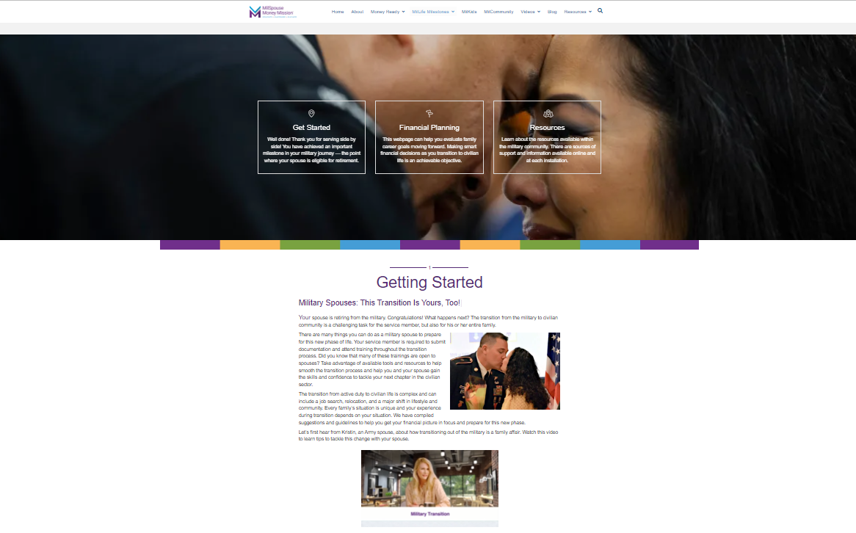

MilSpouse Money Mission
https://www.milspousemoneymission.org/touchpoint-transition-to-retirement/
MilSpouse Money Mission™: Our mission is to educate and empower
military spouses to elevate their families by making smart money moves.

Slide 12


Army JROTC Instructor Opportunities
Benefits of Serving as a JROTC Instructor:
Continue to serve the Nation by impacting the lives of our youth:
Provide leadership to students, many of which come from disadvantaged areas.
Mentor students to become better citizens in their community.
Instill in them the same values you lived by during your career.
Inspire them to become part of something bigger than themselves.
With Army retirement pay and required minimum instructor pay, receive a similar level of compensation to what you received on active duty.
Make an impact not only in the lives of youth but in your community through JROTC service projects.
Be an ambassador for the Army in your community and school.
For more information on vacancies, instructor pay, administrative and medical standards and application procedures, go to http://www.usarmyjrotc.com
Notes:
Administrative & Medical Standards:
Retired three years or less from the Army in grades E-6 through O-6.
No record of military or civilian adverse actions.
Found suitable by Childcare National Agency Check with Inquiries Investigation (CNACI).
Meet the retention medical fitness standards and weight standards of CCR 145-2.
Meet height and weight standard; 30% Male BF and 36% Female BF.
No speech impediment.
No medical disqualifiers (i.e., heart disease, asthma, pacemakers, diabetes).
VA disabilities > 30% require medical review by Command Surgeon.
Have an excellent record of military performance.
Have the mentality, personality, appearance and bearing to represent the Army well in the civilian community.
Have good moral character, instructional ability and be able to challenge, motivate and influence young people in a positive manner.
Completion of initial qualification training, satisfactory interview and be determined by Cadet Command to meet the criteria.

Slide 13
Non-Regular (Reserve) Retirement
Retirement eligibility
  20 years of creditable service for a length of service retirement
  15 years of creditable service for a medical retirement
  If you completed 20 years of service before 25 April 2005, you will have a reserve component service requirement
Retirement Points = Retired Pay: verify yours are correct now!
Reduced Age Retirement
  Eligibility age reduced below age 60, in 90-day increments, for qualifying periods of service within a fiscal year on or after 29 January 2008. On or after 1 October 2014, 90-day increments CAN cross fiscal year boundaries.
  May not be reduced below age 50.
When to Apply to HRC: Request retirement application or download from https://www.hrc.army.mil/content/Gray%20Area%20Retirements%20Branch, 12 months prior to eligibility date. Submit application to HRC NET 9 months and NLT 90 days prior to the date retired pay is to start at usarmy.knox.hrc.mbx.tagd-ask-hrc@army.mil.
The MyArmyBenefits retirement calculator automatically pulls retirement points from IPPS-A!
Notes:
Since 25 Apr 05 there is no longer a requirement for serving a mandatory number of years in the RC before being eligible to retire. Prior to that, the 6 or 8 year rule may apply (See Title 10 USC §12731 for additional info)
NOE=Notification of Eligibility (NOE) for non-regular retired pay at age 60, commonly referred to as the 15 year letter (medical retirement with 15 or more years of creditable service but less than 20) or 20 year letter
Retirement eligibility age may be reduced based off of qualifying periods of active duty service:
-On or after 29 Jan 08, each day on that AD tour counts toward a reduction in retirement age for Reserve Component Service Members. AD orders that qualify for the reduction in retirement age fall under section 101(a) (13)(B), and performed under section 688, 12301 (a), 12302, 12304, 12305, 12406, or chapter 15 (insurrection), or under section 12301 (d) of Title 10 USC.
Days are credited in aggregates of 90 days within a Fiscal Year (see change below). A day of duty shall be included in only one aggregate of 90 days.
NDAA 2015 allows time to cross into the next fiscal year. However, this is not retroactive so only applies to deployments that started after 30 September, 2014.
AD under section 12301 (h) (1) to receive medical care for the wound, injury, or illness, each day of AD under that order for medical care, shall be treated as a continuation of the original call or order to active duty for purposes of reducing the eligibility age of the member.
Active Guard Reserve (AGR) duty under section 12310 of Title 10 USC will not be included as service on active duty for determining eligibility for reduced age retired pay for non-regular service.
In order to apply for a reduced age retirement, you will need your DD Form 214’s and AD orders for the qualifying service.
The NGB Form 23 (RPAM Statement) and DA Form 5016 (Chronological Statement of Retirement Points)…the RPAM/RPAS systems are the systems of record for recording retirement point credit and years of creditable service for retired pay for a non-regular service for USAR and ARNG Soldiers. To earn a “good” retirement year you must earn a minimum of 50 retirement points within an anniversary year.
If you are missing any of the following documents: DA for 5016, 20-Year Letter, DD Form 2656-5 or DD Form 1883, your retirement order, last promotion order, DD Form 214s or AD orders, you can go to the following website and sign into your record using your DS Logon. https//www.hrcapps.army.mil/portal/

Slide 14
Applying for Active Duty
Length of Service Retirement
How
- Officer - Chapter 6, AR 600-8-24
- Enlisted - Chapter 12, AR 635-200
When
- Maximum: 12 months (or up to 24 months*) before desired retirement date
- Minimum: Officers – 9 months before start date of terminal leave
Enlisted – 9 months before retirement date
Where
- General Officers: Notify GOMO at (703) 697-7994/9466 or usarmy.pentagon.hqda-gomo.mbx.gomo@army.mil
- COL & LTC (P): Notify Colonels Management Office at (703) 602-8529 or usarmy.pentagon.hqda-sld.mbx.como-retirements@army.mil
- Army National Guard: State AGR Office (T32); Human Capital Management (T10)
- All others: Local Military Personnel Office
Commander, HRC is the retirement authority for officers with 20-30 years of service and SSG(P) and above not retiring at RCP.
*Application period extended to up to 24 months prior to retirement date under a temporary pilot program during the period 1 Jan 23 - 31 Mar 24 for retirements that occur on or after 1 April 2024.
Notes:
Find instructions for applying for retirement in Chapter 12, AR 635-200 (for enlisted members), and Chapter 6, AR 600-8-24 (for officers).
You can access these ARs via the Army Publishing Agency’s website: https://armypubs.army.mil/.
Soldiers may apply for retirement up to one year (12 months) prior to requested retirement date, but not less than:
9 months prior to retirement date for Enlisted Soldiers
9 months prior to projected start date of terminal leave for Officers.
Soldiers who wish to retire with less lead time should contact their Military Personnel Office to inquire about an exception to policy.
General officers should apply through the General Officer Management Office (GOMO). The Retirement/Promotions Technician’s number is 703-697-9460.
COLs & LTC (P) should apply through the Colonels Management Office-this includes Mandatory Retirements/Recalls. Acquisition Corps officers will still be handled through HRC. The Retirement/Promotions Technician’s number is 703-697-4995.
All others should apply through their Military Personnel Office.
NOTE: The Commander, HRC-Fort Knox, is the retirement approval authority for officers (except GOs, COLs & LTC (P)) who have completed 20 but less than 30 years Federal active service, and for enlisted members in rank SSG(P) and above not retiring at RCP.

Slide 15
Employment Restrictions
Designated Agency Ethics Official (DAEO)
Located in Installation JAG Offices
Source of answers on topics related to post-employment restrictions
Expert on:
  Federal Employment
  Foreign Government Employment
  Negotiations with Employers
  “Switching Sides”
  Rules for Procurement Officials
  Rules Specific to General Officers
  Working During Terminal Leave
  Use of Title & Wearing of Uniform after Retirement.
https://dodsoco.ogc.osd.mil/ETHICS-TOPICS/Post-Government-Employment-and-Procurement-Integrity/
Notes:
Recommend you direct your detailed post-retirement ethics questions to a Designated Agency Ethics Official (DAEO), located at installation legal assistance offices. Use any branch of service.
Post-retirement employment restrictions are covered in DOD 5500.7-R, Joint Ethics Regulation, found at https://www.esd.whs.mil/Portals/54/Documents/DD/issuances/dodm/550007r.pdf
Federal employment: There is a 180-day wait after retirement for DoD employment.
Foreign Government Work: In any capacity, this requires permission from the SecArmy and the Secretary of State. Failure to get permission before starting employment could result in forfeiture of retired pay.
Conflict of Interest: To determine the right course of action, ask yourself if your discussion could embarrass DA if made public? If you think it might, stop your discussion immediately, and seek guidance from a DAEO. And when terminating a discussion, don’t “leave the door open.”
Switching Sides: FOREVER -- you can’t try to influence a federal employee on any particular matter involving non-federal parties in which you participated personally and substantially as a federal official. FOR TWO YEARS -- you can’t try to influence a federal employee on a matter involving non-federal parties that was under your supervision during your last year of active duty.
Miscellaneous: You may accept reimbursement for travel, meals, and the like from a prospective employer IF the employer provides that reimbursement as a matter of course to all others in the same situation. You may also work for the federal government while on terminal leave (but not while in Permissive TDY status).
Procurement: Get details from your DAEO.
General Officer-Specific: GOs have specific additional restrictions, plus must file a statement of public financial disclosure (SF 278) within 30 days after retirement.
This list is NOT an all-inclusive set of rules. Again, visit your DAEO or the Web site above.

Slide 16


Army Transition Assistance Program (TAP)
You may initiate the Army TAP process 24 months before retirement.
You MUST begin the Army TAP process and complete the mandatory Pre-Separation Counseling no later than 365 days before your effective retirement date.
Soldiers need an average of 40 hours, spread over a 12-24 month period of time, to take advantage of Army TAP services.
Consists of:
  - Pre-separation counseling
  - Job assistance workshops
  - Individual counseling
  Job search resources
Army TAP Home Page: https://www.armytap.army.mil/
Notes:
There are 54 Army TAP Centers located at major installations worldwide. They provide extensive transition support services to retiring and separating Soldiers and their family members. Army TAP services can be maximized if begun two years prior to retirement. Services typically provided by Army TAP Centers include:
Pre-Separation Counseling (including completion of the DD Form 2648, “Pre-Separation Counseling Checklist”). Soldiers are informed about transition benefits and services that are available to them. Additionally, they receive assistance in identifying their needs and developing an Individual Transition Plan (ITP). By law, Soldiers must receive required pre-separation counseling a minimum of 90 days before retirement or separation.
Job Assistance Workshops provide clients with the basic knowledge and skills necessary to plan and execute a successful job search. This includes selection of a job search objective, networking, resume and cover letter writing, identification of job opportunities, interviewing and salary/benefit negotiations.
Individual Counseling is provided using the information discussed in the workshops. Counselors help clients identify an objective, write resumes and cover letters, complete job applications, find job opportunities, prepare for interviews and job fairs, and negotiate salary and benefits.
Job Search Resources available for client use include automated job listings such as the Army TAP Job Hot Leads, America’s Job Bank, and the Transition Bulletin Board which contains job listings and news regarding events such as job fairs, automated resume writer, Application for Federal Employment software, and job assistance library.
Services After Retirement are available to Army retirees for life (on a space-available basis). ID card carrying family members are also eligible.
For more information, go to https://www.armytap.army.mil/

Slide 17
Retirement Considerations
Retirement date
  Always the 1st day of the month for length-of-service retirements
  Can be any day of the month for disability retirements
Active-duty service obligation
due to promotion, PCS, completion of military or civilian schooling, etc.
Transfer of the Post-9/11 GI Bill
Service obligation incurred upon transferring Post-9/11 GI Bill benefits to a dependent is not an ADSO, therefore it may not be waived.
Reassigned on a PCS
must complete ADSO requirements to retire (Enlisted AR 635-200, or
Officer AR 350–100)
In lieu of PCS
apply within 30 calendar days of alert for a retirement date no more than
6 months (Officer) or 12 months (or the first day of the month after attaining
20 years AFS, whichever is later, [Enlisted]) from the date of the PCS
alert. (see AR 350–100/AR 600-8-24 [Officer] or AR 635-200 [Enlisted])
Notes:
A length-of-service retirement date is always the first day of the month. A disability retirement can occur on any day of the month.
Upon promotion, Enlisted Soldiers in the grades of E-7 through E-9 incur an ADSO of 36 months (see AR 600-8-19).
The ADSO an officer must serve before being eligible for voluntary separation or retirement is as follows: GEN, LTG—no minimum period but requires the advice and consent of the Senate; MG, BG, COL, LTC–3 years; MAJ, CPT, 1LT–6 months; CW2—no minimum period required; and CW3, CW4, or CW5 will incur a 2–year ADSO. (see AR 600-8-29)
See AR 635-200 (for enlisted members) or AR 600-8-24 (for officers) for the procedures to follow to request a waiver.
If you are notified of a permanent change of station (PCS), and have at least 19 years, 6 months active federal service, you may retire in lieu of accepting the PCS, but you must request a retirement date not later than 6 months (Officer) or 12 months (or the first day of the month after attaining 20 years AFS, whichever is later, [Enlisted]) from the date you were notified of the PCS. The retirement request must be submitted within 30 calendar days of the alert. Soldiers who wish to apply for an exception to this policy should contact their Military Personnel Office.
If a Soldier is reassigned on a PCS from an overseas location to CONUS or from a CONUS location to another CONUS location, he/she would incur a 2-year ADSO before requesting retirement.
A question that is asked frequently is “Will I get the benefit of using the AD pay raise on 1 January if my retirement date is THAT DAY?” The answer, which only impacts those retiring under the Final Pay Plan, is:
Commissioned officers under the FINAL pay plan: (effective 1 Jan 2001), if you retire voluntarily on the same day as an AD pay raise (i.e., 1 Jan), you no longer have to be retirement-eligible at least 30 days prior to the effective date of the AD pay raise in order to use the new AD pay scale in your retired pay calculation. You must have completed at least 20 years and 1 day of service by the day before the effective date of the pay raise (e.g., by 31 Dec).
Enlisted Members Under the Final Pay Plan: are eligible to use the new pay scale. There was never a requirement for you to have been retirement-eligible at least 30 days before the date of the AD pay raise to use that pay scale.
Warrant Officers: have never been able to use the new AD pay scale if you retire on that date. Must wait until the first of the following month to retire in order to get the benefit of using the new AD pay scale.

Slide 18
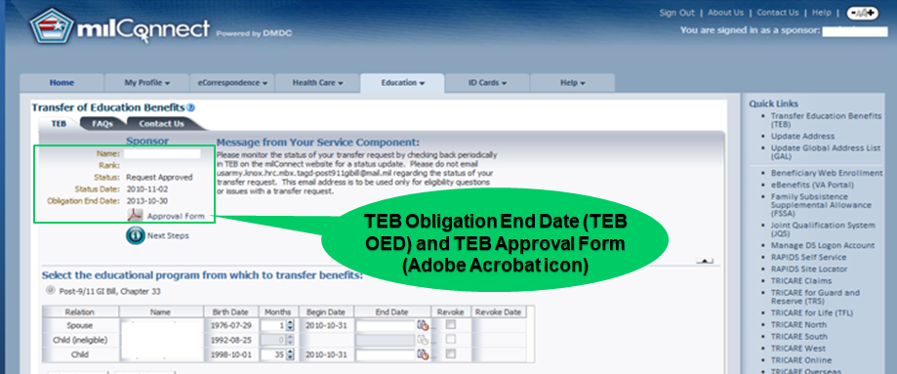
Transfer of your Post-9/11 GI Bill
(https://milconnect.dmdc.osd.mil/milconnect/)
Since 1 August 2013, Soldiers who transfer Post-9/11 GI Bill education benefits to their dependents incur a 4-year service obligation.
If you retire without completing your service obligation, you will incur a debt.
For more information go to the HRC GI Bill Programs page at
https://www.hrc.army.mil/content/GI%20Bill%20Programs
Notes:
For questions regarding the Post-9/11 GI Bill, refer to DoDI 1341.13 located at https://www.esd.whs.mil/Portals/54/Documents/DD/issuances/dodi/134113p.pdf?ver=2018-07-12-084756-290

Slide 19
Authorized vs. Selected
Transition Center (TC)
Authorized to use the TC closest to current duty station
May elect to be processed for retirement at a station-of-
choice
Travel:
  – not paid if to a station-of-choice TC (Soldier will incur cost of travel to
  that location per AR 635-8, para 4-8)
– reimbursement limited to travel actually performed, not to
exceed the allowances from the authorized place of retirement to
the home of selection.
Overseas COLA & Overseas Housing Allowance:
  both stop upon departure from the overseas location
  Basic Allowance for Housing (BAH) paid based on transition
  leave address
  https://www.travel.dod.mil/Allowances/
Notes:
You are authorized to use the Transition Center (TC) closest to your current duty assignment OR you may elect to be processed for retirement at a TC of personal choice.
If you choose a location of personal choice, then the selected TC must be an authorized station-of-choice as prescribed in AR 635-8. Please see the supporting Transition Center to discuss the station of choice option.
Travel:
Is at your expense if to a station of choice.
Reimbursement is limited to travel only in a direct line from your last duty station to your final retirement location.
Overseas COLA and Overseas Housing Allowance both stop upon departure from the overseas location.
BAH is paid to Soldiers who complete all retirement processing at OCONUS location and permanently return to CONUS on transitional leave.
BAH rate will be based on the Soldier’s leave address provided as part of their final out processing.
Note: Soldiers using their OCONUS authorized TC may be granted 30-days Administrative Absence, versus 20-days at their CONUS Station of Choice.

Slide 20
Calculate Your Retired Pay in 3 Steps
Step 1: Determine your Date of Initial Entry into Military Service (DIEMS). **This is the date of your initial service contract. This date does not change regardless of breaks in service or changes in duty status.
Step 2: Determine which pay plan you are eligible for based on your DIEMS date
Step 3: Use the appropriate formula to calculate your retired pay
Where to go to update DIEMS
The brigade/installation Personnel Automation Section POC can correct DIEMS dates.
The local finance office will correct the Defense Joint Military System.
Once a Soldier’s DIEMS can be verified, the changes will be reflected on the ERB/LES.
For a fast, personalized retired pay calculation, go to https://myarmybenefits.us.army.mil/Benefit-Calculators/
and click on the retirement calculator
Notes:
There are four retired pay plans.
To determine which plan you fall under and how your retired pay will be calculated, complete the following three steps. (Additional detail is provided in subsequent slide.)
Step #1. Determine your date of initial entry into Military service, or DIEMS. Unless you know the definition of DIEMS, you won’t know what yours is, and you won’t be able to determine which retired pay plan you are eligible for. DIEMS is explained on the next slide.
Step #2. Determine which pay plan you are eligible for based on your DIEMS. The three pay plans are discussed on the following slides.
Step #3. Use the formula of the appropriate pay plan to calculate your retired pay or just use the retired pay calculator at https://myarmybenefits.us.army.mil/Benefit-Calculators/Retirement. This calculator pulls all your personal data from DEERS to calculate your retired pay on the date you choose.

Slide 21

Thrift Savings Plan
You stop contributing to TSP at retirement
Your options at retirement:
1 - do nothing and draw returns when permitted; or
2 - roll into an IRA or 401K
May resume active participation if you become a federal civilian employee; military and civilian TSP accounts may be combined.
If you are moving, please make sure that you fill out the Form TSP-9 when separating for change of address.
TSP info: https://www.tsp.gov/
Notes:
Upon retirement, you can no longer contribute to TSP.
You have three options:
1 -- leave your money in the TSP (it will continue to draw returns); or
2 -- roll your TSP account into an IRA.
3 – roll other 401k type plans into the TSP
You can resume active participation if you become a federal civilian employee and can combine accounts.
The TSP website https://www.tsp.gov/ offers in-depth tools and information.
If you are moving, please make sure that you fill out the Form TSP-9
when separating for change of address. TSP info: https://www.tsp.gov/

Slide 22
Retired Pay Plans
Retirement Plan | DIEMS
Final Basic Pay Plan (Years of creditable service x 2.5%) x Final Basic Pay | Prior to 8 September 1980
High-36 Pay Plan (Years of creditable service x 2.5%) x average of highest 36 months basic pay | Between 8 September 1980 and 31 July 1986
High-36 Pay Plan (calculation above) ~OR~ Career Status Bonus* (CSB)/REDUX Pay Plan (if you declined CSB, you are automatically High-36) REDUX: (Years of creditable service x 2.5%) minus 1% for each year < 30 years x average of highest 36 months of basic pay *CSB no longer available as of 31 December 2017 | Between 1 August 1986 and 31 December 2017
Blended Retirement System (BRS) (Years of creditable service x 2%) x average of highest 36 months basic pay | 1 January 2018 or later, or opted-in during the opt-in period
NOTE: Credit for all full months served (All). CSB/REDUX receives COLA minus 1%; one-time catch-up COLA at age 62; then COLA minus 1% after age 62. All other Retired Pay Plans receive Full COLAs
Notes:
Credit for all full months served
Final Basic Pay Plan, High-36 Pay Plan and BRS receive Full COLAs
REDUX receives COLA minus 1%; one-time catch-up COLA at age 62; then COLA minus 1% after age 62
Final Basic Retired Pay Plan: Soldiers with a DIEMS prior to 8 Sep 80 will be retired under the Final Basic Pay Plan (T10 USC 1406) receive retired pay equal to 2.5% (called the “percentage multiplier”) of their final basic pay for each full year of creditable service, and 1 1/12th of 2.5% for each full month. Because these Soldiers receive a percentage of their FINAL month’s basic pay, they should avoid retiring just before reaching a basic pay milestone such as over-22 years, over 24 years, over-26 years, over-30 years, over-34 years or over-38 years.
High-36 (High-3) Retired Pay Plan: Soldiers with a DIEMS between 8 Sep 80 and 31 Dec 17 will be retired under the High-3 (High-36) Retired Pay Plan (T10 USC 1407). Those with DIEMS dates from 1 Aug 86 to 31 Dec 17 remain enrolled in the High-3 Plan unless they opted to switch to the CSB/REDUX pay plan in conjunction with reaching their 15th year of active service (see below). The percentage multiplier for Soldiers under the High-3 Plan is the same as that for the Final Basic Pay Plan (2-1/2%), but it is multiplied by the “average of the highest 36 months of basic pay” rather than by the “final basic pay.” The “average of the highest 36 months of basic pay” will typically be the Soldier’s last 3 years of basic pay.
One exception is the commissioned officer who fails to serve 10 years of commissioned service. Under the High-3 Plan, that member will retire at the highest enlisted grade satisfactorily held, and the pay will be a percentage of the average of the enlisted basic pay corresponding to the member’s years of service during the 36 months immediately preceding retirement. Soldiers enrolled in the High-3 Plan who fail to complete their time-in-grade requirement without an approved waiver will retire at the next lower grade, but they will receive a percentage of the average highest 36 months of basic pay, to include the months of basic pay at the higher grade. NOTE: This does not apply to officers who don’t complete 10 years of commissioned service. Waiting until a Soldier reaches a basic pay milestone, i.e., over-22, over-24, or over-26, over-30 years, over-34 years or over-38 years is not critical under the High-3 Plan because the actual highest 36 months of pay are simply averaged.
CSB/REDUX Retired Pay Plan: Soldiers with DIEMS dates between 1 Aug 86 and 31 Dec 17 were given a choice of retired pay plans as they approached their 15th year of active duty, provided they were not undergoing a separation or adverse action. These Soldiers chose to either remain grandfathered in the High-3 Pay Plan or accept the Career Status Bonus (CSB) and therefore fall under the REDUX Retired Pay Plan (T10 USC 1410). The CSB/REDUX percentage multiplier is 2% per year for the first 20 years, 3.5% for years 21-30 and 2.5 % for years 31-40. The more years of service a Soldier completes at retirement, the closer the retired pay under CSB/REDUX is to the retired pay under the High-3 Plan. Also, Soldiers who chose CSB/REDUX will receive annual COLAs that are 1% lower than those received by Soldiers covered under the other two plans. If the COLA is less than 1% for the other groups, the CSB/REDUX group receives nothing. CSB/REDUX retired pay and COLAs are recalculated when the Soldier turns 62 to equal to what the Soldier would have been drawing had he/she retired under the High-3 Pay Plan originally. The following year the COLA is again reduced by 1%; and remains reduced for life. ******NOTE: The CSB/REDUX Retired pay plan ended on 31 December 2017 IAW law under Title 37 USC Section 354 (see Amendment of section), which states "Sunset and Continuation of Payments .-(1) A Secretary concerned may not pay a NEW bonus under this section after December 31, 2017." Since the eligibility criteria and expiration date are established in law, and not policy, there are no exceptions.******
The Blended Retirement System:
TSP: The Blended Retirement System includes a TSP component.
All Service members joining after January 2018, will be automatically enrolled into the TSP at 3% of their base pay, with automatic 1% DoD contributions starting after 60 days, and DoD matching up to 4% at the start of the third year of service.
Both the DoD automatic 1% and the matching contributions continue through the end of the pay period during which the Service member attains 26 years of service.
NOTE: Service members who opted-in to the Blended Retirement System between January 1, 2018, and December 31, 2018 received DoD automatic 1% contribution and up to 4% additional DoD matching beginning the first pay period of election.
MONTHLY RETIRED PAY: For those who retire after at least 20 years of active service, the retirement remains predominantly a defined benefit in which the Service member will get monthly retired pay.
Instead of being calculated at 2.5 percent times the average of the Service member’s highest 3 years of basic pay, the Service member’s monthly retired pay will be calculated with a 2.0 percent multiplier.
LUMP SUM: The lump-sum option gives Service members choices at retirement.
The lump-sum option allows Service members to choose to elect 25% or 50% lump-sum payment at retirement in exchange for reduced monthly retired pay until the Service member reaches full Social Security retirement age, which for most is 67 years old.
The DoD published guidance related to this provision of the Blended Retirement System.
CONTINUATION PAY: The National Defense Authorization Act of Fiscal Year 2016 also included a continuation pay provision as a way to encourage Service members to continue serving in the Uniformed Services.
Continuation Pay is a direct cash payout, like a bonus.
It is targeted at the mid-career mark, between the 8th and 12th year of service.
The DoD publishes guidance related to this provision.

Slide 23
Thrift Savings Plan
Account Withdrawal Deadline
If you decide to leave your money in the TSP, be aware that you will be required to start withdrawing your money when you turn age 72.
As a helpful reminder, the TSP will notify you before your required withdrawal date and mail you important tax information about your TSP withdrawal, as well as information about the IRS required minimum distributions.
Notes:
Upon retirement, you can no longer contribute to TSP.
You have three options:
1 -- leave your money in the TSP (it will continue to draw returns); or
2 -- roll your TSP account into an IRA.
3 – roll other 401k type plans into the TSP
You can resume active participation if you become a federal civilian employee and can combine accounts.
The TSP website https://www.tsp.gov/ offers in-depth tools and information.
If you are moving, please make sure that you fill out the Form TSP-9
when separating for change of address. TSP info: https://www.tsp.gov/

Slide 24
Cost-of-Living Adjustments (COLA)
All Retirement Plans
Based on difference between Consumer Price Index from last
year’s 3rd Qtr CY to current year’s 3rd Qtr CY
Partial first year COLA
Final Basic Pay, High-3 Plan or Blended Retirement System
Full annual COLA
REDUX ($30K CSB) Plan
Reduced until age 62 (COLA minus 1%)
At age 62, one-time catch-up
COLA minus 1% resumes after 62
Notes:
Retired pay typically receives an annual cost-of-living adjustment (COLA). Currently, COLAs are effective 1 December and payable in the retired pay received the first workday of January.
The retired pay COLA on all federal monies, e.g., Social Security, Civil Service, VA, is based on the difference between the Consumer Price Index (CPI) from the 3rd quarter of one calendar year to the 3rd quarter of the next calendar year.
The first year’s COLA for most Retired Soldiers will be a partial one because of their receipt of an active duty pay raise that year. Thereafter, those with retired pay calculated under the Final Basic ,High-3 Pay Plans or Blended Retirement System will receive full COLAs.
Soldiers under the REDUX formula receive the COLA minus 1% until they are 62, at which time they receive a one-time catch-up COLA. Then they revert to COLA minus 1% for life.
One exception is that Soldiers with DIEMS dates on or after 1 Aug 86 who retire for disability with more than 15 years of active service, after having elected to use the REDUX retired pay formula, have their retired pay calculated on the High-3 formula (disability Retired Soldiers can’t use REDUX), they will receive the same reduced COLAs as those whose retired pay is calculated under REDUX.

Slide 25

Retired Pay Facts
Retired pay is paid by DFAS-Cleveland
Payable on the 1st of the month (when the 1st falls on a
weekend or holiday, the pay date is moved to the
previous business day)
Use myPay to make online changes to pay, reissue
1099Rs, change bank accounts, change email or
mailing addresses, change tax withholding, manage
allotments, etc.
Keep correspondence and email addresses current
Monthly electronic Retiree Account Statements (eRAS) are available in your myPay account
https://mypay.dfas.mil/
Notes:
The Defense Finance and Accounting Service’s Cleveland Center (DFAS-CL) pays military retired pay for ALL uniformed services Retired Soldiers and annuitants (except the Public Health Service).
You are required to use Electronic Funds Transfer (EFT) (also called direct deposit) to a financial institution for your military retired pay. If your pay will continue to the same financial institution that you used on active duty, a new direct deposit form is not required; the DD Form 2656, Data for Retired Pay, will suffice. Changes to a financial institution after retirement require either an SF 1199A (Direct Deposit Form) or an FMS 2231 (Fast Start Direct Deposit Form).
Retired Soldiers sometimes fail to notify DFAS-CL of a change to their home mailing (correspondence) address. Please be sure and change your correspondence and email with DFAS-CL so that address can be used in the mailing of important documents such as pay statements, tax forms, Army Echoes, and installation retiree newsletters.
DFAS-Cleveland’s mailing address is: Defense Finance and Accounting Service, US Military Retired Pay, 8899 E 56th Street, Indianapolis IN 46249-1200. The DFAS customer service toll-free number is 1-800-321-1080; their website is: https://www.dfas.mil/. This information is provided in every issue of Army Echoes.
We encourage the use of the online pay system called myPay: https://myPay.dfas.mil NOTE: The PIN you use in the myPay system as an active duty member can be carried into retirement.
myPay allows you to change your federal and state withholding taxes and exemption status; stop, start, or change allotments; change your correspondence address; update your financial institution EFT information; request a replacement IRS Form 1099R; and start, stop and change bonds. You can even opt to “turn off” hard-copy mailing of your annual Retiree Account Statement.
Your Retirement Services Officer (RSO) has access to the Retired Pay database and can assist you in making any pay changes if you’re unable to accomplish them through myPay or via contact with Cleveland.

Slide 26


Dividing Retired Pay as Property If Divorced
Uniformed Services Former Spouses' Protection Act (USFSPA)
NOT AUTOMATIC
Up to state courts and can be any amount
For divorces after 23 December 2016, a service member’s disposable income to be divided is limited to the amount of basic pay based on pay grade, years of service, and pay table at the time of the court order with COLA increases.
This change in law under T10 USC section 1408, states that the date of divorce will be used to calculate a share of retired pay, NOT the retirement date. This law change cannot be retroactively applied.
Award not tied to length of marriage
DFAS direct payment requirements:
  Marriage overlapped 10 years with service
  Limited to 50% of “disposable” retired pay**
**In cases where there are payments both under the USFSPA and a garnishment for child support or alimony, the total amount payable cannot exceed 65% for garnishments.
https://soldierforlife.army.mil/Retirement/former-spouses
https://comptroller.defense.gov/Portals/45/documents/fmr/Volume_07b.pdf (chapter 29)
Notes:
A final topic related to payment of retired pay…
Despite what many people think and what many people advise, the division of military retired pay as property between a divorcing couple is NOT AUTOMATIC. Simply, federal law states that retired pay may be divided, and leaves the decision on whether it will be divided as alimony or property up to the state courts. Division as property is restricted to disposable retired pay only.
Disposable retired pay = gross retired pay less amounts which:
- the Soldier owes to the U.S. for previous overpayments of retired pay
- the Soldier owes for recoupments required by law resulting from entitlement to retired pay
- are deducted for court martial fines
- are waived to receive civil service or VA disability compensation
- are based on disability (for court orders issued on or after 14 Nov 86)
- are deducted because of an election under the Survivor Benefit Plan (SBP) to provide an annuity to a spouse or former spouse to whom payment of a portion of such Soldier’s retired pay is being made pursuant to a court order
- are owed the U.S (for court orders issued before 3 Feb 91)
- are withheld for federal and state taxes, consistent with the Soldier’s tax liability (for court orders issued before 3 Feb 91)
Although retired pay may be divided with a former spouse, DFAS will not send that pay directly to the former spouse unless a federal requirement is met – that the marriage overlapped at least 10 years of the Soldier’s service creditable for retired pay. If the court awards a former spouse a portion of retired pay as property, but the 10-year overlap of marriage and service creditable for retired pay is not met, the Soldier is obligated to pay the former spouse through other means.

Slide 27
Allotments
In retirement, permitted to have:
  - Maximum of 6 discretionary allotments
  You can have unlimited non-discretionary allotments.
  For recalled Soldiers at retirement:
  - NONE continue from active duty
  - ALL must be re-initiated after separation
  WHY? DFAS-CL has no interface with DFAS-IN
  Can start/stop/change allotments in myPay at https://myPay.dfas.mil
More information available at: https://www.dfas.mil/retiredmilitary/manage/allotments.html
Instead of creating an allotment through DFAS, some allotments can be easily and freely set up directly with your bank to pay bills (e.g. life insurance) or save for the future (e.g. transfer to another bank account).
Notes:
Retired Soldiers are authorized six “discretionary” allotments and unlimited “non-discretionary” allotments.
Discretionary allotments include, but are not limited to: payment of premiums for health, auto, or life insurance; voluntary payments to a dependent, former spouse and relatives; deposits into a financial institution, mutual fund or investment firm; payment of an auto or personal loan, mortgage, rent, and consumer debts.
Non-discretionary allotments include, but are not limited to: US Government Savings Bonds; payment of delinquent taxes; contributions or repayment of loans to AER; and any court-ordered garnishment.
You can start, stop, or change an allotment by letter, or online via myPay, using your SSN and personal identification number (PIN). More information on myPay is available at -- https://myPay.dfas.mil. Please see http://www.dfas.mil/retiredmilitary/manage/allotments.html
Allotment starts and stops are effective the first day of the month specified by the member, if the authorization reaches DFAS-CL 10 days before pay day.
An allotment may be started for Veterans Group Life Insurance (VGLI).
AER automatic contributions period runs from 1 June through 31 May annually.
AER Contributions: A Soldier who is making an AER contribution through payroll deduction from active duty pay may carry it over into retired pay without completing new paperwork. However, DFAS will stop the payroll deduction at the end of May, and the Retired Soldier must re-start the allotment.
AER loans: AER loans, on the other hand, DO NOT continue into retirement. Soldiers repaying AER loans through deductions from active duty pay must complete new paperwork to continue the loan repayment into retirement.

Slide 28

MyArmyBenefits
Featuring a personalized
Retirement Calculator!!
Benefit Library
  Federal Fact Sheets
  State and Territory Benefits Fact Sheets
  Resource Locators
Benefit Calculators
  Retirement
  Survivor Benefits
  Deployment Calculator
Casualty Operations Special Module
  Survivor Benefits Report
Benefits Help Desk Operations
Benefit Library
Help Desk
https://myarmybenefits.us.army.mil
Benefit Calculators link directly to DEERS information through CAC or DS Logon.
Notes:
28

Slide 29
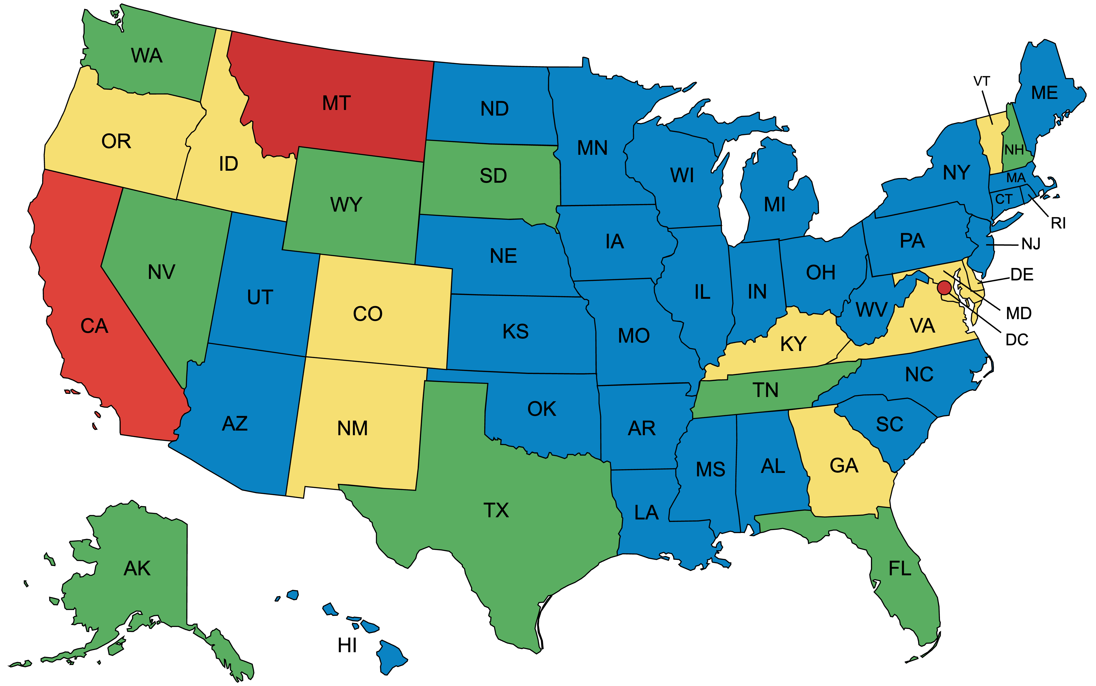

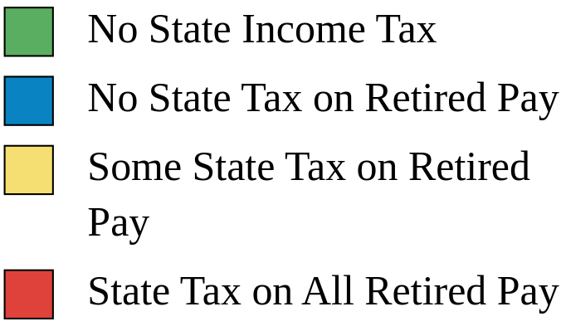


Taxes*
Federal taxes are due on all retired military compensation
Home of Residence is determining factor; not Home of Record!
You pay NO Social Security or Medicare tax on retired pay. You’ll collect full Social Security benefits when you reach the age of eligibility!
*State taxes as of 20 April 2023. Conditions or limitations apply. Check state law. See the MyArmyBenefits state fact sheets at https://myarmybenefits.us.army.mil/Benefit-Library/State/Territory-Benefits for details.

Slide 30

Army Emergency Relief
Helping the Army take care of its own since 1942
Did you know…
AER’s sole mission is to provide emergency financial assistance to relieve the distress of Army personnel, Retired Soldiers, and their families.
As a Retired Soldier, you are eligible for all categories of assistance, and you may continue to contribute through an allotment from your retired pay.
Also awards scholarships to spouses and children of Retired Soldiers.
For assistance, contact the AER section on your nearest Army installation, other service aid societies or the American Red Cross.
You can continue taking care of Soldiers who are still currently serving as well as fellow Retired Soldiers by setting up an allotment from your retired pay or by making an annual donation to AER.
More information available at https://www.armyemergencyrelief.org/
Notes:
AER is a private nonprofit organization incorporated in 1942 by the Secretary of War and the Army Chief of Staff.
Assistance includes no-interest loans and grants for emergency travel, rent, utilities, dental, auto repairs, cranial helmets, furniture and more
AER provides scholarships for spouses and children. Awarded based on need, or academics or demonstrated leadership.

Slide 31
Take Terminal Leave or Cash it in?
USE Leave
Take accrued leave as terminal leave
Terminal Leave is ordinary leave granted to assist separating Soldiers with their personal affairs
Still draw a paycheck
Full benefits while you are on terminal leave (BAH, BAS, incentive pay, etc.)
CASH IN Leave
Cash in/sell up to 60 days
(you can only cash in a total
of 60 days over the course
of your entire career)
Leave that you sell back is
automatically taxed at 25%
Federal tax plus state tax
When you sell leave back, it
will be base pay only. You do
not get benefits such as BAH,
BAS, incentive pay, etc.
Notes:
AR 600-8-10, Leaves and Passes, governs leave.
Please contact installation Finance Office for further information.

Slide 32

Transition Administrative Absence*
*Formerly known as Permissive TDY (PTDY). At Commander’s Discretion.
Purpose: Facilitate transition to civilian life (e.g. house-hunting, job-hunting, CSP)
10 Days (and may be authorized an additional 10 days):
CONUS-based Soldiers
OCONUS-based Soldiers (at same OCONUS location)
10 Days (and may be authorized an additional 20 days):
CONUS-based Soldiers who entered active duty from OCONUS and will return to OCONUS
OCONUS-based Soldiers, at a CONUS or another OCONUS location
Career Skills Program (CSP):
For approved CSPs outside of a 50-mile radius, up to 120 days (w/COL or higher approval) or 30 days (w/COL or delegated field grade commander approval)
Not able to combine with other Administrative Absences, leaves, or passes
AR 600-8-10, Leaves and Passes
Notes:
Ref: AR 600-8-10, Personnel Absences, Leaves and Passes.
Retiring Soldiers, with their commander’s permission, may take an additional 20 (or 30) days leave to house or job hunt in conjunction with their retirement. This leave is called Administrative Absence and is a non-chargeable, optional absence.
Soldiers must apply for it at their MILPO using DA Form 31. It is in addition to any accrued regular leave.
Commanders in the field retain the flexibility to reduce the number of Administrative Absence/terminal leave days where readiness and mission accomplishment would be impaired.
Under exceptional circumstances, commanders may grant 10 additional days of Administrative Absence to OCONUS-based Soldiers who will transition and reside in the same OCONUS location, giving them a total of 30 days Administrative Absence .
You may not begin employment while in Administrative Absence status.
Administrative Absence may be used in increments or in one continuous period, as follows:
Once Soldiers depart their duty station or station of choice, they may not take Administrative Absence in increments.
If used in increments, there must be at least one duty day between the last increment and the start of terminal leave. For example, a Soldier eligible for 20 days of Administrative Absence is retiring 1 Jul. The Soldier had previously used Administrative Absence in increments totaling 15 days. The Soldier is taking 7 days of terminal leave, so the Soldier’s last duty day is 23 Jun. The last day of Administrative Absence must end no later than 22 Jun so the Soldier has one duty day (23 Jun) before starting terminal leave.
Administrative Absence taken in increments begins at 0100 on the first Administrative Absence day and ends at 2400 on the last Administrative Absence day. Therefore, a Soldier taking 5 days Administrative Absence from Mon through Fri would depart on Administrative Absence Mon morning at 0100 and return on or before 2400 Fri. Administrative Absence begins and ends on post, at the duty location, or at the location where the Soldier regularly commutes to and from work.
If Administrative Absence is used in one period in conjunction with terminal leave, there does not need to be a duty day between the last day of Administrative Absence and first day of terminal leave. For example, a Soldier retiring 1 Jul is taking 7 days of terminal leave. The Soldier’s last duty day would be 23 Jun. If the Soldier takes 20 days of Administrative Absence in conjunction with the terminal leave, the Soldier’s last duty day would be 3 Jun.
A spouse MAY travel space-available, unaccompanied, at the same priority as those on ordinary leave, within CONUS on a Administrative Absence house-hunting trip.
Soldiers must sign off Administrative Absence and sign onto ordinary leave (terminal leave) to begin working.
For additional information and application form for the Career Skills Program, refer to https://home.army.mil/imcom/index.php/customers/career-skills-program

Slide 33
Retirement Physical
The Army requires a Separation History and Physical Exam (SHPE) prior to retirement
Physical exams performed by the DoD are valid for up to 12 months before the date of retirement*
Your last record of active-duty health
Assists with claim for VA service-connected disability
Most sites now provide combined Service and VA retirement physicals
Use the results of your retirement physical to apply for VA disability benefits under the:
Benefits Delivery at Discharge (BDD) Program (90-180 days left)
Fully Developed or Standard Claim (1-89 days left)
VA goal is to start disability payments within 60 -120 days of retirement. Visit the VA web site at https://www.va.gov/disability/how-to-file-claim/when-to-file/pre-discharge-claim/#ways-to-file or call 1-800-827-1000
* DA PAM 40-502, paragraph 6-7
Notes:
Army policy requires that you obtain a retirement physical in order to document disabilities that might exist at the time of your retirement. The results of this physical will also facilitate your application for VA disability compensation for injuries or illnesses incurred in or aggravated by Military service. (NOTE: This VA process is recommended for all retiring Soldiers).
Per existing Service/VA agreements, there are (as of 1 Jan 06) more than 40 locations that offer a combined Service/VA retirement physical, as part of the goal of offering a more seamless transition.
Although you may still be examined by both Army and VA doctors in conjunction with your retirement and subsequent application for VA disability compensation, the goal is to have Soldiers receive only one physical serving both purposes. We can report that this is being done in a large majority of sites. It will be performed one of three ways:
By an Army doctor in an Army facility using VA protocol
By a VA doctor in an Army facility
By a VA doctor in a VA facility
You must obtain the physical no more than 4 months, but no less than 1 month, before your retirement date or the date you will start terminal leave/Transition Administrative Absence. This will ensure that the results of the physical have time to be placed in your medical record before it is sent to the VA in support of your application for service-connected disability compensation (further discussed in an upcoming slide).
https://www.va.gov/disability/how-to-file-claim/when-to-file/pre-discharge-claim/#ways-to-file

Slide 34
Separation History and Physical Exam (SHPE)
Separation Health Assessment:
The Separation Health Assessment is a medical evaluation used by the Department of Defense (DOD) and the Department of Veterans Affairs (VA).
  In the DOD, it is referred to as the “Separation History and Physical Examination (SHPE)” - A SHPE up to 90 days prior to retirement date must be validated as current not more than 30 days before the retirement date.
  In the VA, it is called a “Separation Health Assessment” - When conducted by the VA, an exam up to 180 days prior to the date of retirement from active duty is acceptable. (must be validated by a DOD official).
Soldiers who are retiring:
  Only need one exam.
  The exam may be completed at a military hospital or clinic (http://www.tricare.mil/MTF) or at a VA facility (https://www.va.gov/find-locations/).
The Separation Health Assessment documents and assesses your:
  Medical history
  Medical concerns identified during your military career
  Current health status
Notes:
VA Retirement Physical clinic locator: https://www.va.gov/directory/guide/division.asp?dnum=3
Military hospital or clinic locator: https://www.tricare.mil/MTF
Excerpt from DA Pam 40-502, paragraphs 6-7(b), (d), (e), (l) and (m) regarding the Separation History and Physical Exam (SHPE) as follows:
b. The SHPE program has specific timeline requirements outlined in the SHPE user guide to ensure that the required SHPE exam is complete and validated by 30 days from separation. The requirement for a physical exam within 12 months of separation is fixed; other interval timelines may be adjusted for terminal leave as allowed by DOD and VA policy.
d. When the Soldier is filing a service-connected disability claim, complete the physical examination through the VA, when possible, prior to separation. The VA refers to SHPEs as Separation Health Assessments.
e. The Soldier completes the DD Form 2807–1 and DD Form 2808 in the medical readiness system of record. If the physical is over 6 months (180 days) from retirement and needs to be updated, the DD Form 2697 (Report of Medical Assessment) will also be completed in the medical readiness system of record. The Soldiers who are filing a VA claim will need to adhere to VA policies and procedures, ensure their claim is initiated and their medical records are available to the VA to support their SHPE and any additional exams. The VA will complete the SHPE for Soldiers between 180–90 days from separation.
l. In accordance with 10 USC 1145(a)(5), the SHPE occurs immediately before the scheduled separation. With the consent of the Soldier and concurrence of the unit commander, the requirement may be met in any of the ways shown below. No more than 30 days prior to separation, there must be an administrative review and validation of the qualifying SHPE by completing block 85 on the DD Form 2808. When the Soldier has terminal leave, the final out-processing date may be used in lieu of the date of separation from active duty for the timeline requirements (other than the 12-month period).
(1) A SHPE up to 30 days prior to the date of separation from active duty requires no further documentation.
(2) A SHPE up to 90 days prior to the date of separation from active duty must be validated as current not more than 30 days prior to the date of separation. Such validation is an administrative requirement and does not require a separate entry into the STR, though an entry may be made if necessary for tracking purposes.
(3) When conducted by the VA, a separation exam up to 180 days prior to the date of separation from active duty is acceptable. In accordance with DODI 6040.46, a DOD official must review the VA performed exam and make an entry into the STR. The presence of this entry must be administratively validated as current no more than 30 days prior to the date of separation from active duty.
(4) A DOD physical exam performed between 90 days and 12 months prior to separation from active duty if it meets the SHPE minimum standards and is updated with a new medical assessment no more than 30 days prior to separation from active duty and documented in the STR.
m. When accomplished incident to retirement, discharge, or REFRAD, medical examinations, including the SHPE and annual PHA, are valid for a period of 12 months from the date of examination or assessment.

Slide 35
SHPE – How it Works
Schedule your exam at a military hospital or clinic or VA facility well in advance of your scheduled separation date. (see locator links on previous slide)
  If you’re filing a VA claim, schedule it no later than 90 days before your retirement date.
  If you’re taking extended terminal leave, it’s best that you schedule at a military hospital or clinic.
Before the exam, complete DD Form 2807-1 (Report of Medical History) at https://www.esd.whs.mil/Portals/54/Documents/DD/forms/dd/dd2807-1.pdf
The assessment results are then accessible by both the DOD and VA. You can also access them by using the Blue Button at http://www.tricareonline.com/. You won’t need another exam if you decide to file a VA claim.
Notes:
VA Retirement Physical clinic locator: https://www.va.gov/directory/guide/division.asp?dnum=3
Military hospital or clinic locator: https://www.tricare.mil/MTF
Excerpt from DA Pam 40-502, paragraphs 6-7(b), (d), (e), (l) and (m) regarding the Separation History and Physical Exam (SHPE) as follows:
b. The SHPE program has specific timeline requirements outlined in the SHPE user guide to ensure that the required SHPE exam is complete and validated by 30 days from separation. The requirement for a physical exam within 12 months of separation is fixed; other interval timelines may be adjusted for terminal leave as allowed by DOD and VA policy.
d. When the Soldier is filing a service-connected disability claim, complete the physical examination through the VA, when possible, prior to separation. The VA refers to SHPEs as Separation Health Assessments.
e. The Soldier completes the DD Form 2807–1 and DD Form 2808 in the medical readiness system of record. If the physical is over 6 months (180 days) from retirement and needs to be updated, the DD Form 2697 (Report of Medical Assessment) will also be completed in the medical readiness system of record. The Soldiers who are filing a VA claim will need to adhere to VA policies and procedures, ensure their claim is initiated and their medical records are available to the VA to support their SHPE and any additional exams. The VA will complete the SHPE for Soldiers between 180–90 days from separation.
l. In accordance with 10 USC 1145(a)(5), the SHPE occurs immediately before the scheduled separation. With the consent of the Soldier and concurrence of the unit commander, the requirement may be met in any of the ways shown below. No more than 30 days prior to separation, there must be an administrative review and validation of the qualifying SHPE by completing block 85 on the DD Form 2808. When the Soldier has terminal leave, the final out-processing date may be used in lieu of the date of separation from active duty for the timeline requirements (other than the 12-month period).
(1) A SHPE up to 30 days prior to the date of separation from active duty requires no further documentation.
(2) A SHPE up to 90 days prior to the date of separation from active duty must be validated as current not more than 30 days prior to the date of separation. Such validation is an administrative requirement and does not require a separate entry into the STR, though an entry may be made if necessary for tracking purposes.
(3) When conducted by the VA, a separation exam up to 180 days prior to the date of separation from active duty is acceptable. In accordance with DODI 6040.46, a DOD official must review the VA performed exam and make an entry into the STR. The presence of this entry must be administratively validated as current no more than 30 days prior to the date of separation from active duty.
(4) A DOD physical exam performed between 90 days and 12 months prior to separation from active duty if it meets the SHPE minimum standards and is updated with a new medical assessment no more than 30 days prior to separation from active duty and documented in the STR.
m. When accomplished incident to retirement, discharge, or REFRAD, medical examinations, including the SHPE and annual PHA, are valid for a period of 12 months from the date of examination or assessment.

Slide 36

VA Compensation for
Service-Connected Disability
VA rates disabilities 0% - 100%
Each % has an assigned dollar amount
Basic rates effective 1 December 2022 (Veteran only): from $165.92 (10%) to $3,621.95 (100%), (30% & higher = Extra dependent allowance)
Tax free payments
For Retired Soldiers <50% disabled, disability pay offsets military retired pay dollar for dollar
Free VA medical care for service-connected conditions
0% rating means a condition is service-connected, but is not severe enough to merit disability pay
https://www.benefits.va.gov/compensation/types-compensation.asp
Notes:
This is how the VA disability compensation process works.
​When your combined conditions total more than 10%, you will receive a monthly tax-free compensation from the VA. (Unless you are rated 50% or more - under current law, your VA tax-free compensation amount offsets your Military retired pay $-for-$.)
Each percentage of disability pays a set dollar amount which is increased by COLA each year. It is unrelated to your grade, rank, or Military retired pay amount. (It was de-linked from pay grade in 1993.)
A rating from the VA of 30% disabled or higher provides additional monthly amounts to you, based on the number of dependents you have, to include your spouse.

Slide 37
Applying to the VA for Service-Connected Disability
Lifetime reevaluations and appeals available from VA
VA ID card expedites future VA care
Survivor annuity, Dependency and Indemnity Compensation (DIC) payable if your death is service-connected
$10K (or $30K) Service-Disabled Veterans Insurance (S-DVI) policy available to disabled
At retirement, you have easiest access to your medical records to support your claim (can apply at any time)
https://www.va.gov/disability/
Notes:
The following VA-related slides offer a fairly general overview of VA programs applicable to Retired Soldiers. There are MANY, MANY MORE PROGRAMS that you can learn about by visiting the VA homepage at: https://www.va.gov.

Slide 38
VA Service-Connected Disability Compensation Rates as of 1 Dec 22
https://www.va.gov/disability/compensation-rates/veteran-rates/
Notes:
This slide shows the tax-free VA compensation amounts in effect as of 1 Dec 2021. These amounts receive a COLA each 1 Dec.
When a Veteran is rated 30% or more disabled, an additional amount is paid for eligible dependents (e.g., spouse, child, parent).
The additional amount for a child is dependent upon the child’s age and the Veteran’s disability percentage rating. Different rates are paid for children under 18, and children over 18 but under 21 and in school.
Special Monthly Compensation (SMC) is paid to permanently housebound Veterans or those in need of the aid and attendance of another person.
Consult the Web site: https://www.va.gov – see Benefits – for a more complete listing of compensation amounts/categories.
The VA Disability Compensation Benefits Rate Tables are available at https://www.va.gov/disability/compensation-rates/veteran-rates/

Slide 39
CRSC & CRDP Comparison
Combat-Related Special Compensation | Concurrent Retirement and Disability Pay
Combat-related disabilities | Service-connected disabilities
Armed conflict (e.g. wounds) Simulated combat (e.g. FTX) | Retired pay that would have been waived by the Soldier in order to receive disability pay is restored (i.e., no $ for $ off-set of retired pay)
Hazardous service (e.g. parachute duty)
Instrumentalities of war (e.g. combat vehicles)
10%-100% disability rating (combat-related) | 50%-100% disability rating (service-connected)
Not taxable; not divisible in divorce | Taxable; divisible in divorce
Receiving retired pay | Qualified retiree receiving retired pay*
Must apply to HRC | Automatic; no application required
https://www.hrc.army.mil/TAGD/Apply%20for%20CRSC | https://www.dfas.mil/retiredmilitary/disability/crdp.html
*A member or former member of the uniformed services who is entitled for any month to retired pay is a qualified retiree. (Special Rules for Chapter 61 Disability Retirees)
Notes:
CRDP – Qualified Retirees
Any retiree (other than Chapter 61 with less than 20) *see below
Chapter 61 retiree with 20 years of 1405 service is qualified at disability retirement date
Chapter 61 retiree with 20 years of 12732 service is qualified at non-regular retirement eligible age
With a qualifying disability (50% or more) from the VA
CRDP – Not Qualified Retirees
Chapter 61 retirees with less than 20 years of service are not qualified retirees for CRDP, years of service computed under section 1405 or 12732

Slide 40
Retirement and Disability Payments
Tying It All Together
Retired pay is reduced dollar-for-dollar by VA Disability Pay unless the Soldier qualifies for Concurrent Retirement and Disability Pay (CRDP)
(50-100% VA
Disability)
Example
Only
(0% VA
Disability)
(10-40% VA
Disability)
(10-40% VA
Disability)
Retired Pay
Disability Pay
CRSC
NOTE: Example depicts four Soldiers retired at the same pay grade and years of service
Notes:
This slide compares four Soldiers who retired from active duty at the same pay grade with the same number of years of service. All amounts are for example purposes only and do not reflect any particular Soldiers or ranks. All retired pay from DFAS is Federally taxable and State taxable unless you live in certain states and all is divisible in divorce. All VA disability pay and CRSC pay are nontaxable and nondivisable in divorce.
Soldier A receives $2000 of retired pay from DFAS and has no service-connected disabilities.
Soldier B receives $2000 of retired pay, but also receives $500 of disability pay from the VA (he is rated between 10% and 40% disabled), so his retired pay is reduced dollar-for-dollar by his disability pay. He receives $1500 taxable pay from DFAS and $500 of nontaxable pay from the VA. Soldier B’s disabilities are all service-connected, but none are combat-related.
Soldier C is the same as Soldier B except that some of his disabilities are combat-related, so, in addition to his $1500 retired pay from DFAS and $500 disability pay from VA, he receives $250 of CRSC pay from DFAS.
Soldier D receives $2000 of retired pay from DFAS, but he is rated between 50% and 100% disabled by VA, so under CRDP, he receives his full $2000 retired pay from DFAS and his full $750 disability pay from VA. Soldiers cannot receive both CRDP and CRSC; DFAS will choose whichever is better for the Soldier unless the Soldier makes his own choice. Soldiers may switch between CRDP and CRSC, if entitled to both, one time per year.

Slide 41



Medical Records
Belong to the Government per AR 40-66
Make a copy of your records
Make a copy of Family member records
May be difficult to obtain copies after retirement
Can be placed on CD or emailed (Varies by record type)
Notes:
Military medical records are the property of the Department of Defense.
Recommend you make a copy of your and your family’s medical records before retiring. Your Military Treatment Facility (MTF) will assist you in this.
Your original medical record is sent to the VA Regional Center nearest your selected home of residence, along with your application for service-connected disability. https://www.archives.gov/veterans/military-service-records/medical-records.html
If the VA ultimately awards you service-connected disability, your medical record will remain at the VA regional office servicing you. If service-connected disability is not granted, your medical record will be sent to the VA Records Center in St. Louis, MO.
Military medical facilities transfer your family members’ medical records to the NPRC, generally 1-5 years after last treatment. Upon request, they will be sent to the MTF closest to your retirement residence, or a copy will be made and sent to a private physician or hospital. https://www.archives.gov/personnel-records-center/other-medical-records

Slide 42
Gulf War Veterans
DOD and VA offer a free Gulf War Registry Health Exam for eligible Veterans
  DoD: Comprehensive Clinical Evaluation Program (CCEP)
  VA: Gulf War Registry Program
Exam results entered into central registry
Family members and survivors may also be eligible for benefits
Receive newsletter
Applies to any Veteran who served on active military service for any period from August 2, 1990, to the present and meets the wartime service requirement.
https://www.publichealth.va.gov/exposures/gulfwar/
Notes:
In an effort to capture early data which may eventually lead to a presumption of service-connection for medical conditions specific to service in the first Gulf War, and Operations Iraqi and Enduring Freedom (OIF/OEF), DoD and the VA have teamed up to offer free medical evaluations through two programs -- DoD’s Comprehensive Clinical Evaluation Program (CCEP), and the VA’s Persian Gulf Registry. Results of the medical exams are entered into a central database, or registry, for further evaluation.
DOD’s CCEP: This program is available to Gulf War veterans who are currently in one of the active or reserve components, or who are already retired. Call 1-800-497-6261, Mon-Fri, 8:00 AM (EST) to 4:30 PM (EST) to schedule an appointment. Information is available on the Web at http://www.gulflink.osd.mil and https://www.health.mil/Military-Health-Topics/Health-Readiness/Environmental-Exposures/GulfLINK/Gulf-War-Medical-Evaluation-Programs.
VA Gulf War Registry: This program is available to Veterans who are no longer in the military service. Call 800-PWG-VETS (800-749-8387) to schedule an exam. If overseas, call the nearest U.S. Embassy and ask for the Foreign Benefits Unit. Info is also available at http://www.va.gov.
VA Family Member Exams: Family members of Veterans who obtain exams through the VA program are also eligible for an exam at any of 33 VA medical centers nationwide (the list of participating centers is on the VA homepage). Note: Family member medical conditions discovered during the VA exam cannot be treated by VA doctors. They will be referred to their own doctors for treatment. And, although pediatricians are not available to examine children, children are eligible for an exam.
Newsletters: VA's Environmental Health Program publishes the Gulf War Review newsletters, providing information especially for Veterans who served in Operations Desert Shield and Desert Storm. Subscribe to email updates and notices of published newsletters at: https://www.publichealth.va.gov/index.asp

Slide 43

SGLI & VGLI
You must apply to convert SGLI to VGLI within one year and 120 days from discharge.
If you submit a VGLI application within 240 days after discharge, you can obtain coverage regardless of health.
You can retain VGLI for as long as you pay the premiums.
Premiums may be paid by allotment, check, or money order, if paid monthly
Discounts are offered for the following pay schedules:
  quarterly (2.5%)
  semi-annually (3.75%)
  annually (5%)
All terminally ill policyholders with less than 9 months to live will be eligible to take up to 50% of their SGLI or VGLI coverage in a lump sum.
Applying for VGLI is simple using one of the following methods:
  Apply through the Office of Servicemembers’ Group Life Insurance (OSGLI), https://giosgli.prudential.com/osgli/OnlineFillableAppController/NBEnrollment
  Download and complete SGLV 8714, Application for Veterans' Group Life Insurance and Fax it to OSGLI at 800-236-6142, or mail it to: PO Box 41618, Philadelphia, PA 19176-9913
https://www.benefits.va.gov/insurance/index.asp
Notes:
Servicemember’s Group Life Insurance (SGLI) protection for members and Family SGLI (FGSLI) continues without further cost through the 120th day following retirement.
If you are totally disabled at the time of separation (unable to work), you can apply for the SGLI Disability Extension, which provides free coverage for up to two years from the date of separation. While you do not need to apply for SGLI coverage, an extension of SGLI due to total disability is not automatic. You must apply to the Office of Servicemembers' Group Life Insurance (OSGLI) for the extension. At the end of the extension period, you automatically become eligible for VGLI, subject to premium payments.
Once enrolled in VGLI, you will have the opportunity to increase your coverage by $25,000 every five years up to the legislated maximum of $400,000, until age 60.
Spouses/children are not eligible to convert to VGLI. Spouses, however, are eligible to convert their FSGLI to commercial insurance without a physical, using participating insurance companies, within 120 days of the member’s retirement.
You have 1 year and 120 days from your date of separation to apply for VGLI. If you apply for coverage within 240 days of your date of separation, you will not need to answer health questions.
VGLI is renewable in 5-year increments for life, and can be cancelled at any time. You will pay a higher premium rate at each renewal increment.
You may pay your premiums monthly, quarterly, semi-annually, or annually. If you choose to pay other than monthly, you will receive the following discounts: quarterly = 2.5%, semi-annually = 3.75%, annually = 5%.
If you choose to pay monthly, you have the option of having your premiums deducted from your Military retirement pay or disability compensation. If you select this mode of payment, you must still submit the first month's premium with your application (see box 4 of the application).
VGLI may be converted at any time (IAW PL 104-275) to a commercial policy without a physical, but you will pay the rates for your age group at the time of conversion. VGLI cannot be converted to term insurance. A list of participating companies will be provided to you by VGLI.
Holders of SGLI/VGLI policies who have been diagnosed as terminally ill, with less than nine months to live, can receive up to 50% of the face value of their policy. Increments of less than 50% are also available. The SGLI/VGLI premium will be adjusted to reflect the reduced face value of the policy. The election may not be made more than once, and it is irrevocable. https://www.benefits.va.gov/insurance/abo.asp
For more information on SGLI and VGLI, go to: http://benefits.va.gov/insurance/sgli.asp - http://benefits.va.gov/insurance/vgli.asp
A sample of rates are provided on the next slide.

Slide 44
VGLI Premium Schedule – Monthly Rates
Insurance Amount | Ages 40-45 | Ages 45-49 | Ages 50-54 | Ages 55-59 | Ages 60-64 | Ages 65-69 | Ages 70-74 | Ages 75-79 | Ages 80 & Over
$400K | $64.00 | $84.00 | $132.00 | $240.00 | $396.00 | $588.00 | $904.00 | $1,712.00 | $1,800.00
$300K | $48.00 | $63.00 | $99.00 | $180.00 | $297.00 | $441.00 | $678.00 | $1,284.00 | $1,350.00
$250K | $40.00 | $52.50 | $82.50 | $150.00 | $247.50 | $367.50 | $565.00 | $1,070.00 | $1,125.00
$200K | $32.00 | $42.00 | $66.00 | $120.00 | $198.00 | $294.00 | $452.00 | $856.00 | $900.00
$150K | $24.00 | $31.50 | $49.50 | $90.00 | $148.50 | $220.50 | $339.00 | $642.00 | $675.00
$100K | $16.00 | $21.00 | $33.00 | $60.00 | $99.00 | $147.00 | $226.00 | $428.00 | $450.00
$50K | $8.00 | $10.50 | $16.50 | $30.00 | $49.50 | $73.50 | $113.00 | $214.00 | $225.00
https://www.benefits.va.gov/insurance/vgli_rates_new.asp
Notes:
Current Monthly Premium Rates Effective as of April 1, 2021. The VGLI premium rates were lowered and an additional age category (80 & over) was added.
Premiums are those associated with your nearest age on the 121st day after retirement OR your age on date of application, whichever is later.
VGLI premium rates are determined by age group and insurance amount.
To lessen the high cost of term insurance at the older ages, Veterans should consider gradually reducing the amount of their VGLI coverage. The following is a suggested coverage reduction schedule that will allow the veteran to maintain a level premium while reducing coverage:
Age Group Coverage Level Premium
65-69 $150,000 $225*
70-74 $100,000 $230*
75 & over $50,000 $230*
Following this schedule, the Veteran’s monthly premium would remain $225/$230 from age 65 on.*
VGLI proceeds are payable in either a lump-sum or over a 36-month period.

Slide 45
Veterans Affairs Life Insurance (VALife)
Veterans Affairs Life Insurance (VALife) provides low-cost coverage to Veterans with service-connected disabilities. VALife is guaranteed acceptance whole life insurance.
For age 80 or younger:
  You’re eligible for VALife if you have a VA service-connected disability rating, even if your rating is 0%.
  There’s no time limit to apply after getting your disability rating.
You can get these benefits:
  Up to $40,000 in whole life insurance coverage (in $10,000 increments), and
  Cash value that starts to add up 2 years after the VA approves your application
https://www.benefits.va.gov/insurance/VALife.asp

Slide 46
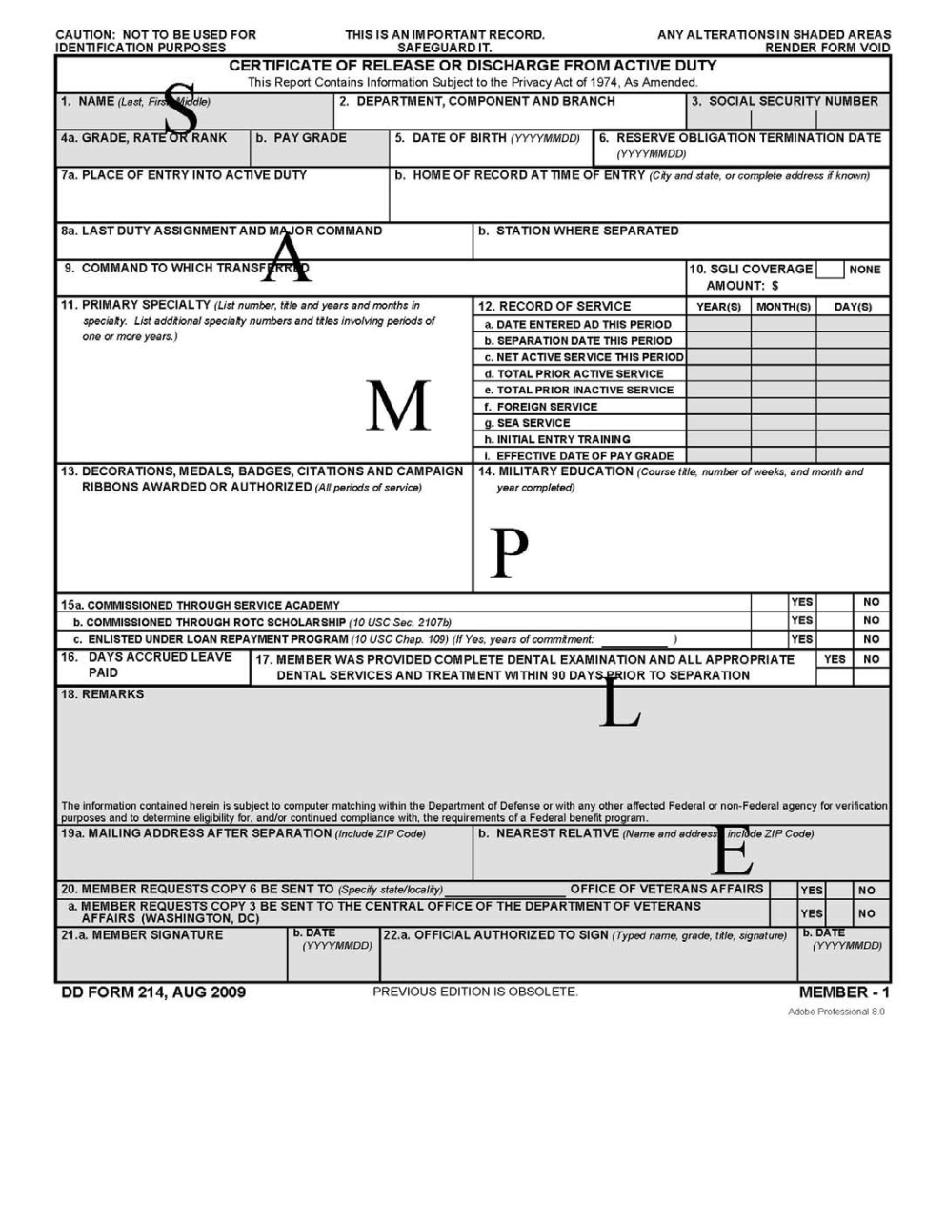
DD Form 214 (Certificate of Release or Discharge from Active Duty)
Check for accuracy before signing - Your personal responsibility!
Copies*:
  #1 – Member; this is the short form version
  #2 – Service; automatically sent to the interactive Personnel Electronic Records Management System (iPERMS)
  #4 – Member; only member copy that contains reason for discharge; of interest to some employers
  #8 – File Copy for transition center (maintained for 1 year)
File your copies (1 & 4) in a safe place (NOT a courthouse unless they assure you that it will not be accessible by the general public!)
*Reference, AR 635-8 para 7-2
(Note: Due to the electronic transmission of DD Form 214 data to the Defense Manpower Data Center (DMDC), Military Services are no longer required to produce and distribute paper copies 3, 5, 6, 7, and 8 of DD Form 214)
Notes:
Your DD Form 214, Certificate of Release or Discharge from Active Duty, might be the most important document you receive at retirement, as it documents your Military service. Ensure it is 100% correct before signing it.
It is an 8-page form, with some distribution specifics, as follows:
Copy #1 is the “short version” of the DD 214, and does not have the reason for separation included; you receive this copy.
Copy #2 is the Military’s copy; it’s filed at the National Personnel Records Center.
Copy #3 accompanies your medical records and application for VA disability to the VA Regional Center that holds jurisdiction for your permanent address.
Copy #4 is the only copy that lists the narrative reason for your discharge. Employers and others may want to see Copy #4 along with Copy #1 (the original). You will receive it by initialing Block 30 of the form.
File your copies (1 & 4) of the 214, and ensure your family knows how to access them. Possible future needs include your applying for Social Security benefits, and your family’s applying for your burial in a national/state veterans cemetery. We recommend using a fire-safe container or one of the Military organizations that holds personal documents as assistance they provide you and family members in applying for Military-related benefits.
Whatever you do, DO NOT FILE YOUR DD FORM 214 AT A COURTHOUSE unless they assure you that it will not be accessible as a matter of public records (due to increasing incidents of identity theft.) Some states have enacted legislation to protect DD214s.
Officers with no break-in-service may have only one DD form 214.
Before 1 October 1979, enlisted Soldiers received a DD Form 214 for each reenlistment. After that, a DD Form 214 was issued to enlisted personnel only upon separation or retirement, providing there was no break in service.

Slide 47
Obtaining a Copy of Your DD Form 214
Copies of a Retired Soldier’s DD Form 214(s) may be obtained from the following sources, as applicable:
Retired Soldiers may access their records through the HRC My Records Portal by logging in with their DS login at https://www.hrcapps.army.mil/portal/ and clicking on “Reserve/Retiree/Veteran Record”
Retired Soldiers separated after 1 October 2002 who do not have DD Form 214(s) available in iPERMS, forward request to Commander, U.S. Army Human Resources Command (AHRC-PDR-H), 1600 Spearhead Division Avenue, Fort Knox, KY 40122 (Note: records are stored electronically at AHRC but requests can also be serviced by the National Personnel Records Center, see link below)
Retired Soldiers and Veterans who register for a premium DS Logon can obtain copies of DD Form 214(s) from iPERMS through MilConnect. https://www.va.gov/records/get-military-service-records/
Soldiers who retired prior to 1 October 2002, can submit a request to the National Personnel Records Center https://vetrecs.archives.gov/VeteranRequest/home.html
Installation military personnel divisions or ARNG State headquarters may provide Soldiers and Veterans with copies of DD Form 214(s) available in iPERMS.

Slide 48
At Retirement, You Will Also Receive…
DD Form 363, Certificate of Retirement
DD Form 2542, Presidential Certificate of Appreciation for Service in the Armed Forces of the United States – Presented to Soldiers retiring with 20 or more years of active service (15 when early retirement authorized), medical retirements, upon transfer to the Retired Reserve (reserve components), TDRL or PDRL
Presidential Letter of Appreciation - Presented to service members retiring with 30 or more years of service, or special category (e.g., CSA, SMA, Medal of Honor Recipient or former POWs who qualify for or have been awarded the POW Medal)
Retirement Ceremony (optional)
DA Form 3891, Army Spouse Certificate of Appreciation (if applicable)
Army Retiring Soldier Commendation Program (ARSCP) Package (see next slide)
Notes:
You will be given the opportunity to participate in a retirement ceremony.
You will also receive a retirement certificate, spouse appreciation certificate (if applicable), Army Retiring Soldier Commendation Program Package - (U.S. Flag, U.S. Army Retired Lapel Button, Soldier for Life window decals, and a Tri-Signed Letter). These items are usually provided by your Transition Center, but sometimes units prefer to provide them during a unit ceremony.
You will receive a CERTIFICATE of Presidential Recognition if you retire from Military Service, IAW DODI 1348.34
You will receive a LETTER of Presidential Recognition if you have completed at least 30 years of service, or are in one of the following special categories: Chairman or Vice Chairman, JCS; CSA; SMA; Recipient of the Medal of Honor; Former POW who qualifies for or has been awarded the POW Medal, IAW DODI 1348.34.
U.S. flags are issued to all Soldiers who retire from active duty on or after 1 Oct 98 (T10 USC section 7251), or from a reserve component on or after 1 Oct 99 (T10 USC Section 12605). Reserve Component Soldiers are eligible to receive a U.S. flag when they have completed the years of service required for eligibility for retired pay under T10 USC chapter 1223.

Slide 49
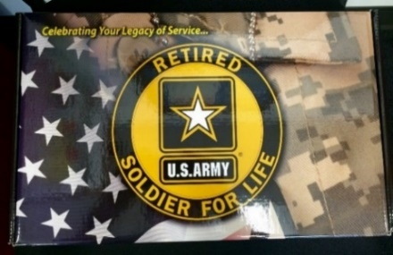


Army Retiring Soldier Commendation Program
The Army Retiring Soldier Commendation Program package (ARSCP), was created by ASA (M&RA) in 2009
Flag required by Title 10 USC §7251 (active duty retirement) since 1998 and T10 USC §12605 since 1999 (reserve component service retirement)
U.S. Army Retired Lapel Button required by Army policy since 1968 IAW AR 600-8-22
Presented to Active Duty Soldiers at retirement and to Reserve Component Soldiers upon transfer to the Retired Reserve or discharge after reaching retirement eligibility
Package contains a letter signed by the Secretary of the Army, the Army Chief of Staff, and the Sergeant Major of the Army, a U.S. Flag, a U.S. Army Retired Lapel Button, and two Soldier for Life window decals.
Installation, State, RD/MSC Retirement Services Officers order ARSCP packages
Notes:
U.S. flags are issued to all Soldiers who retire from active duty on or after 1 Oct 98 (T10 USC section 7251), or from a reserve component on or after 1 Oct 99 (T10 USC Section 12605). Reserve Component Soldiers are eligible to receive a U.S. flag when they have completed the years of service required for eligibility for retired pay under T10 USC chapter 1223.

Slide 50

Mobilization/Retired Soldier Recall
Criteria for recall
  Must meet medical fitness standards
  Must meet grade and skill requirements
  Must have required security clearance
  Retired Soldiers who volunteer for recall to AD are not subject to any age or grade limitation. Retired Soldiers involuntary ordered to AD are subject to age and grade limitation.
By Category
  Cat I: Non-disability, retired less than 5 years, under 60
  Cat II: Non-disability, retired 5 years or more, under 60
  Cat III: Retired Soldiers including those retired for disability or any retired member over age 60. Generally, category III personnel should be assigned to civilian jobs, unless they have critical skills or volunteer for specific military jobs.
https://www.hrc.army.mil/content/Retiree%20Recall
Notes:
Per AR 601-10 chapter 2 (Recall and Selection Criteria), paragraph 2-2 (Criteria for recall) and para 2-10 (Retired Soldier Categories)
Retired Soldiers can be recalled to active duty in the event of a full mobilization or national emergency as determined by the President and Congress. They are assigned to an installation from a database maintained by the Mobilization Section at AHRC – Fort Knox, KY. Mobilization orders are not cut until needed. Every effort is made to assign Retired Soldiers to an installation within 300 miles of their homes.
Retired Soldiers in Category I are more likely to be recalled than those in Category II. Those who wish to volunteer at a particular installation should send their request to Human Resources Command. If there is a slot available at that installation, the Retired Soldier will be placed in it.
Retired Soldiers may be deployed.
Retired Soldiers in Category III are not recalled; however, they may volunteer for mobilization pre-assignment. Requests will be considered on a case-by-case basis.
Retired Soldiers must notify Defense Finance & Accounting Service, U.S. Military Retired Pay, P.O. Box 7130, London, KY 40742-7130 of address changes. The My Record area of HRC site enables most Reserve Soldiers access to update their own contact information including address, phone numbers and email address changes.
For more information about the retiree mobilization program:
The Team email address is: usarmy.knox.hrc.mbx.rpmd-ord-retiree-recall@mail.mil. All Retiree Recall packets must be submitted by the requesting Command to the Team mailbox.
The POC phone number is: 502-613-4911

Slide 51
Travel & Transportation
(Contact Your Transportation Office)
Travel
Authorized from last duty station to home of selection (includes Family members)
If home of selection is OCONUS, costs limited to those payable had a CONUS site been selected
Transportation of Household Goods (HHGs)
From last duty station to home of selection
May ship stored HHGs
Non-temporary storage authorized for 1 year
If retiring OCONUS, POV shipment to CONUS authorized

Slide 52

Travel & Transportation (Con’t)
(Contact Your Transportation Office)
Time Limit on Travel & Transportation Allowances
Has been increased from one to three years from the date of retirement (for those with retirement orders issued on or after 24 June 2022)
Extensions may be requested prior to the 3rd anniversary of the retirement date, and each year thereafter, up to a maximum of 6 years.
Additional Info Sources: Defense Transportation Regulation 4500.9-R, found at https://www.ustranscom.mil/dtr/dtrp4.cfm and the Joint Travel Regulation at https://www.defensetravel.dod.mil/Docs/perdiem/JTR.pdf
*Note: Soldiers whose retirement orders were issued before 24 June 2022 may continue to request extensions on an annual basis up to a maximum of six years from the Soldier’s retirement date.
Notes:
Your Transportation Officer (TO) is your EXPERT on travel/transportation allowances associated with retirement. Details are too numerous to include in this slide. So, please visit your TO in sufficient time to accomplish a successful retirement move.
Travel is authorized to a retiree’s home of selection, provided the member had at least eight years of continuous active duty (with no single break of more than 90 days) immediately preceding retirement. Your Home of SELECTION (HOS) at retirement does not have to be the same as Home of RECORD (HOR).
Travel to your HOS must be completed within three years of retirement. Exceptions can be granted. Contact your TO before the third anniversary of your retirement if you wish to request an extension.
Ordinarily, dependents are entitled to the same travel allowances as the member. Eligible family members may commence travel prior to the effective date of the retirement.
Dislocation allowance is NOT payable to a retiring member.
Household Goods (HHGs) may be shipped from your last duty station to HOS.
HHGs in storage or from a previously designated place in the U.S., or any combination of these places, may also be shipped to the HOS. Retired grade determines weight and cost limitations.
Non-temporary storage of HHGs is also authorized for a period of one year from retirement date. HHGs that are not placed in non-temporary storage may be placed in temporary storage for a period of 90 days pending shipment to the HOS. Extensions of these storage periods are granted under certain conditions. Again, your TO can give you details of how/when/where to apply for extensions.
Personnel retiring from overseas locations may ship a POV to CONUS. Land transportation of POVs is not authorized.

Slide 53
Personal Property Household Goods (HHG)
Entitlements expire 6 years from the effective date of the orders
Extension of the transportation entitlement
  Submit an extension request to the transportation office prior to the retirement anniversary date (see previous slide).
  An extension of the 1-year time limit for HHG in non-temporary storage (NTS) may be authorized or approved through the Secretarial Process if a Service member is undergoing hospitalization or medical treatment, or is recalled to active duty before selecting a home
Local move of HHG
  Authorized from government/privatized quarters to a residence in local area
  Local move radius varies by installation. (within service area)
  Does not impact the move to the HOS
  HHG may be split between the delivery to the local residence and non-temporary storage (NTS)
  HHG in the residence in the local area and in non-temporary storage (NTS) may be transported to the HOS at a later date
  Local move weight allowances listed in the Joint Travel Regulation, Table 5-37

Slide 54
Personal Property Household Goods Storage
Shipments to multiple locations
  Total weight of all shipments may not exceed the authorized weight allowance
  Total cost of all shipments may not exceed the cost to ship the authorized weight allowance to the HOS in one lot.
Non-temporary Storage (NTS) is always at origin, not at destination
Begins on the date the order is issued
Terminates 1 year from the effective date of retirement
After the 1 year entitlement expires, storage is converted to a commercial account at the Soldier’s expense. Contact the transportation office for a delivery out of storage.
When HHG are released for delivery, additional storage is not authorized, it must be a DIRECT delivery.
Think non-temporary storage first, place HHG in NTS when HOS is unknown or delivery address at HOS is unknown, or new house being built.

Slide 55
ID Cards
Same privileges as active duty (with some being Space-A)
Family members need new ID cards to reflect sponsor’s retired status
Children are eligible up to age 21 or 23 if full-time student; indefinite if incapacitated
Permanent ID card to Family members at age 65 or who
are permanently disabled; under 65 renew every 4 years*
Dependent parents/parents-in-law may qualify
*Note: The Under Secretary of Defense for Personnel and Readiness (USDP&R) signed a memorandum approving a change to this policy on 21 September 2020, lowering the age of eligibility for a permanent ID from age 75 to age 65. This change will be captured at a later date in an update of DoDI 1000.13.
FIND NEAREST ID CARD ISSUING FACILITY
https://idco.dmdc.osd.mil/idco/
Notes:
You and your family members must obtain new ID cards upon retirement to reflect your new status.
A retiree’s ID card does not expire. A family member’s card must be renewed every four years until age 75. A dependent child is eligible for an ID card until age 21, or 23 if a full-time unmarried student, or any age if incapacitated before age 21 or 23 and dependent upon the retiree for more than 50% of their support.
05NDAA: Permanent ID card to retired dependent at age 75.
07NDAA: Permanent ID card to retired dependent who is permanently disabled.
Check with your nearest ID card issuing office regarding WHEN retirement cards may be issued. If a retiree card is obtained before departing on terminal leave, carry a copy of your retirement orders with you until your retirement date in case there’s a medical emergency. This is important because TRICARE benefits are different for active duty and retired members/Families.
If you plan to travel overseas and wish to use the PX and commissary systems, check with an RSO serving the destination country because privileges overseas are severely limited by Status of Forces Agreements (SOFA) with host countries.
Many people don’t realize that a parent/parent-in-law who is dependent upon the Retired Soldier for more than 1/2 of their support is eligible for an ID card with all privileges except medical care.
Retired Soldiers and their eligible spouses will still have access to benefits and they'll still be enrolled in the Defense Enrollment Eligibility Reporting System, but the expiration date - which is one day before their 65th birthday - is a reminder to retirees that they must enroll in Medicare Part A and B to retain their TRICARE for Life eligibility,
Contact the nearest ID Card Issuing Facility for more details.

Slide 56
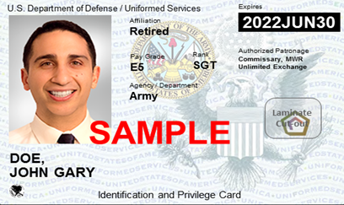
Impact of ID Card Changes at Retirement
Soldier turns in Common Access Card (CAC)
The Retired Uniformed Services ID (USID) card is not a CAC, so…
  No access to DOD Enterprise Email
  No access to CAC-enabled systems
  Must change myPay account to commercial email
  Must obtain DS Logon Account to access records and systems
DoD has transitioned to the issuance of a more secure next generation USID to replace the former paper-based USID. Although the new USID looks like a CAC, it does not contain a chip. For more information go to https://www.cac.mil/Next-Generation-Uniformed-Services-ID-Card/
DS Logon: Request an account online at
https://www.dmdc.osd.mil/identitymanagement
or visit an ID Card facility or VA Regional Office

Slide 57

Websites Accepting DS Logon
• Army Review Board Agency (ARBA) Case Tracking System (ACTS)
• Army Transition Assistance Program (TAP) Portal
• ArmyFit - U.S. Army Resilience Directorate (ARD)
• Beneficiary Web Enrollment (BWE)
• Consolidated ID Card Office Online
• eBenefits
• U.S. Army Human Resources Command (HRC) - interactive Personnel
Electronic Records Management System (iPERMS) and My Record Portal
• milConnect
• Military Health System GENESIS Patient Portal (MHS GENESIS Patient Portal)
• Military Information Platform (MIP)
• My Military Health System GENESIS (MY MHS GENESIS)
• Remote Order Entry System - (ROES)
• TRICARE Online (TOL) (website and mobile app)
• U.S. Department of Veterans Affairs (VA)
https://www.dmdc.osd.mil/identitymanagement

Slide 58
Former Spouse ID Card
Authorized ONLY if:
  The marriage and the sponsor's creditable service overlapped by at least 20 years – OR –
  The marriage and the sponsor's creditable service overlapped by at least 15 years but less than 20 years.
OVERLAP PRIVILEGE(S)
20+ years…………………………….Full (medical, commissary, exchange, MWR)
15 years, but less than 20………....Medical care (for 1 yr from date of divorce)
Less than 15 years………………….None
Note: A former spouse is not eligible for medical benefits if enrolled in an employer-sponsored health plan. Benefits terminate upon remarriage of the former spouse.
Notes:
In order for a former spouse to qualify for an ID Card, the marriage and the service creditable for retired pay must have lasted 20 years each. This means that former spouses of Soldiers who retire for disability with less than 20 years service or under The Temporary Early Retirement Authority (TERA) are not eligible. Likewise, former spouses who were not married to the Military member for at least 20 years are ineligible.
Three scenarios exist:
1 -- If both the marriage and the service creditable for retired pay lasted at least 20 years, benefits are then determined by the number of years the marriage and service overlapped. If the overlap of the two is 20 or more years (i.e., “20-20-20”), the former spouse is entitled to an ID card granting full benefits (medical, commissary, PX, theater).
-- If an otherwise eligible former spouse is enrolled in an employer-sponsored health care plan, the former spouse is not entitled to medical care. However, if the former spouse disenrolls from the employer-sponsored plan medical benefit can be restored effective the date of disenrollment (AR 600-8-14 and AFI 36-3026(i)).
2 -- If the overlap of the two is at least 15 years but less than 20 years (i.e., “20-20-15”), the former spouse is entitled to an ID card granting one year of TRICARE Standard (TRICARE Standard is discussed later in this seminar) -- with the one year period commencing from the date of divorce.
-- Exception: “20/20/15” former spouses whose divorces occurred before 1 Apr 85 are entitled to Military medical benefits and TRICARE Standard indefinitely. Medical benefits for 20/20/15 former spouses whose divorces were finalized on or after 1 Apr 85, but before 1 Oct 88, have expired.
-- If an otherwise eligible former spouse is enrolled in an employer-sponsored health care plan, the former spouse is not entitled to medical care. However, if the former spouse disenrolls from the employer-sponsored plan medical benefit can be restored effective the date of disenrollment (AR 600-8-14 and AFI 36-3026(i)).
3 -- If the overlap of the two is less than 15 years, the former spouse is not entitled to an ID card.
Former spouses who remarry lose eligibility for medical benefits permanently.
Former spouses who do not qualify for an ID card, or who qualify for only one year of medical care, are eligible to enroll in the Continued Health Care Benefit Program (CHCBP) -- a private, group health insurance plan. A former spouse must enroll within 90 days of the date medical benefits terminate; however, a former spouse who missed the 90-day window should still inquire. Enrollment is limited to 36 months unless the former spouse is entitled to a court-ordered division of retired pay. Contact your nearest installation Health Benefits Advisor (HBA) for more information on CHCBP.

Slide 59

Healthcare Decisions. . .
See https://www.tricare.mil for more details
When On Active Duty
  you are enrolled in TRICARE Prime and pay no fees
  your family members pay no enrollment fees, but must choose a TRICARE option and apply for enrollment in TRICARE Prime
When You Retire. **You must reenroll within 90 days of your retirement date to avoid a lapse in coverage.**
  TRICARE Prime – Managed care option. MTFs are principal source of health care (100% covered)
    Annual fee is $703.92 per family or $351.96 per individual plus co-pays for treatment at non-MTF TRICARE network providers.
  TRICARE Select – Fee for Service Plan. Schedule appointments with any TRICARE authorized provider.
    Annual fee ($345/family, $171.96/individual), plus copays and cost shares based on the type of care and type of provider you see. Deductible of $150 (individual), no more than $300 per family.
  TRICARE Young Adult – for children between ages 23 and 26
    Not subsidized. Premiums are $570 per month (Prime) or $291 per month (Select), plus copays and cost shares.
NOTE: CY 23 Group A rates reflected
Notes:
You must enroll in either TRICARE Prime or TRICARE Select by the effective date of retirement to be eligible for continuous health care coverage.
The next several slides present a very broad overview of a retiree’s healthcare options using TRICARE, TRICARE-for-Life, TRICARE Retiree Dental Plan, and the TRICARE Pharmacy program.
This slide highlights what your options are while on active duty, and what changes when you retire.
The TRICARE program is very complex and warrants an in-depth briefing from an expert.
You can get a higher level of information at the TRICARE website https://www.tricare.mil and from any installation Health Benefits Advisor (HBA).
TRICARE beneficiaries fall into one of two groups: Group A or Group B
You’re in Group A if your initial enlistment or appointment or that of your uniformed services sponsor began before Jan. 1, 2018.
You’re in Group B if your initial enlistment or appointment or that of your uniformed services sponsor began on or after Jan. 1, 2018.
Note: When enrolled in TRICARE Reserve Select (TRS), TRICARE Retired Reserve (TRR), TRICARE Young Adult (TYA), or the Continued Health Care Benefit Program (CHCBP), Group A beneficiaries follow Group B deductibles and applicable copayments or cost-shares.

Slide 60
TRICARE Coverage - Retired RC Soldiers
Retired Reserve Coverage Timeline
Under age 60 | 60 | 61 | 62 | 63 | 64 | Age 65+
Gray Area Retired Soldiers May qualify to purchase TRICARE Retired Reserve | Eligible for TRICARE Select TRICARE Prime or US Family Health Plan (where available) |  |  |  |  | Begin TRICARE For Life
Note: TRICARE Standard and TRICARE Extra plans transitioned to TRICARE Select. Retired members will need to choose between TRICARE Select, TRICARE Prime, or US Family Health Plan
For information and assistance: https://tricare.mil/Plans/HealthPlans
Notes:
Upon turning age 60 and collecting retirement pay, TRR members are disenrolled from TRR and may be eligible for other TRICARE programs as retirees, such as:
TRICARE Select
TRICARE Prime (if in a PSA), including the US Family Health Plan
TFL
If entitled to premium-free Medicare Part A at age 60 or older, Retired Reserve members must also have Medicare Part B to be TRICARE-eligible. Before age 65, these beneficiaries have the option to use TRICARE Prime or TFL. At age 65, coverage transitions to TFL.
Note: If a beneficiary is not entitled to premium-free Medicare Part A, Medicare Part B is not needed to keep TRICARE. In this case, the beneficiary won’t transition to TFL. If you aren’t entitled to premium-free Medicare Part A when you turn 65 under your own Social Security number, or SSN, but your spouse is, you must file for benefits under your spouse’s (this includes divorced or deceased spouses) SSN if he or she is 62 or older. Go to https://tricare.mil for more information

Slide 61
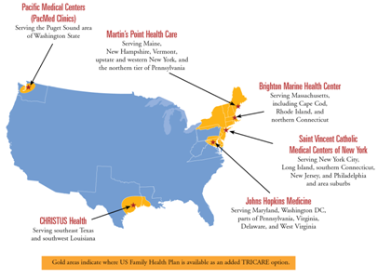
Healthcare Decisions . . .
US Family Health Plan
  Began as US Public Health Service hospitals
  TRICARE Prime Option for Retired Soldiers
  and eligible family members up to age 65
  https://www.usfhp.com/ or (800) 748-7347
  The annual fee is $703.92 per family or
  $351.96 per individual
Department of Veterans Affairs
  Vets separated under any condition other than dishonorable including Army Reserves or Army National Guard called to active duty by a federal order who completed the full period
  Some Vets may be required to pay a co-pay for treatment of their non-service-connected conditions. Private health insurance may reduce or eliminate the co-pay
  Most Vets must complete a financial assessment at time of enrollment
  https://www.va.gov/health/ or 1-877-222-VETS (8387)

Slide 62

Federal Employee Dental and
Vision Insurance Program (FEDVIP)
FEDVIP replaced the TRICARE Retiree Dental Program (TRDP) and offers supplemental vision coverage to those enrolled in a TRICARE health plan
There are 12 dental and 5 vision carriers to choose from
    FEDVIP also offers national and international plans, with some plans featuring both high and standard options
Retiring service members can enroll in a FEDVIP dental and/or vision plan between 31 days prior to their military retirement date and up to 60 days following
    To prevent a gap in coverage between your active duty or reserve plan and your new FEDVIP plan, you must enroll prior to your military retirement date
BENEFEDS is the online portal that you can use to research, enroll in, and manage your FEDVIP coverage
Visit https://www.benefeds.com/military for more information
Notes:
Federal Employee Dental and Vision Insurance Program (FEDVIP)
FEDVIP is a voluntary, enrollee-pay-all dental and vision insurance program. It replaces the former TRICARE Retiree Dental Program (TRDP) and offers supplemental vision coverage to those enrolled in a TRICARE health plan.
In general, retired uniformed service members, their families, and survivors are eligible for FEDVIP dental coverage and, if enrolled in a TRICARE health plan, FEDVIP vision coverage.
In addition, family members of active duty uniformed service members who are enrolled in a TRICARE health plan are eligible for FEDVIP vision coverage. (Active duty uniformed service members are not eligible for FEDVIP dental and vision coverage.)
With 12 dental and 5 vision carriers to choose from, FEDVIP offers choice and flexibility for you and your family:
National and international plans, with some plans featuring both high and standard options
A choice between three enrollment types: self, self plus one, or self and family
FEDVIP is sponsored by the U.S. Office of Personnel Management (OPM) and is popular among federal employees; the more than 5 million people already enrolled give the program high marks for quality and value.
So when can you enroll?
If you are retiring from the uniformed services, you have a 91-day enrollment window to enroll in a FEDVIP dental and/or vision plan.
You are eligible to enroll between 31 days prior to your military retirement date and 60 days following.
To prevent a gap in coverage between your active duty or reserve plan and your new FEDVIP plan, you must enroll prior to your military retirement date.
Please note, enrollment is not automatic. If you don’t enroll within 60 days following your retirement date, you will need to wait until the next Federal Benefits Open Season to do so.
FEDVIP is a payroll/annuity deduction program.
You are encouraged to visit BENEFEDS, the secure online portal to enroll in FEDVIP to research FEDVIP’s current list of carriers and plans and use the site’s plan comparison tool to view rates, benefits, and coverage information. BENEFEDS.com/military is the page dedicated to military families, including those transitioning into retirement.

Slide 63

VA Dental Care
No-cost dental care MAY be furnished if you–
Have a service-connected compensable (10% or greater) dental
disability or condition -or-
Are a former prisoner of war -or-
Have service-connected disabilities rated 100% (total) disabling, or are unemployable and paid at the 100% rate due to service-connected disabilities -or-
Request dental care within 180 days of discharge (under conditions other than dishonorable) from a period of active duty of 90 days or more
  On a one-time basis
  Not eligible if necessary treatment was completed by dental treatment
facility within 180 days of retirement (reflected on DD Form 214)
Or other qualifying condition (see link below for additional information)
If you are not eligible for VA Dental Care, the VA implemented a national VA Dental Insurance Program (VADIP) to provide enrolled Veterans and CHAMPVA beneficiaries the opportunity to purchase dental insurance through Delta Dental or MetLife at a reduced cost. Participation is voluntary and purchasing a dental plan does not affect Veterans current eligibility for VA dental services and treatment.
https://www.va.gov/dental/
https://www.va.gov/health-care/about-va-health-benefits/dental-care/dental-insurance/
Notes:
One final important word in this seminar on the topic of DENTAL treatment -- this time related to the VA.
No-cost VA dental care MAY be furnished to veterans in these categories if space and resources permit.
For more information on VA dental care eligibility, contact the nearest VA medical center, or go on-line at https://www.va.gov/dental/.
the VA is implementing a comprehensive national VA Dental Insurance Program (VADIP) to give enrolled Veterans and CHAMPVA beneficiaries the opportunity to purchase dental insurance through Delta Dental and MetLife at a reduced cost. Participation is voluntary and purchasing a dental plan does not affect Veterans current eligibility for VA dental services and treatment.

Slide 64


Space-Available Travel
Retired Soldiers may travel within CONUS or
OCONUS
Space-A registration is valid for 60 days from the date of receipt at the origin departure location of choice
Eligible travelers can sign up for the Space-A list online at https://www.amc.af.mil/AMC-Travel-Site/AMC-Space-Available-Travel-Page/Space-Available-Email-Sign-up-Form/ or by completing AMC Form 140 and bringing (or faxing) it to the nearest AMC Passenger Terminal
Benefit ends for Family members with death of the Retired Soldier
https://www.amc.af.mil/AMC-Travel-Site/AMC-Space-Available-Travel-Page/
Notes:
Oftentimes, Military flights throughout the world have vacant seats. Active and Retired Soldiers and their eligible family members who are traveling unofficially may fill those seats on a space-available (Space-A) basis. The Retired Soldier and Family member have a lower priority than the active duty Soldier.
Since eligible family members must be accompanied by the sponsor, the Space-A travel benefit ends for Family members when the Retired Soldier dies.
You no longer need to wait AT an air terminal for the next vacant flight. You may FAX your request in and stay on the list for up to 60 days. During that time, you may decline any available flights without your name being removed from the list.
Books on Space-A travel are available for purchase through the Army & Air Force Exchange System.

Slide 65


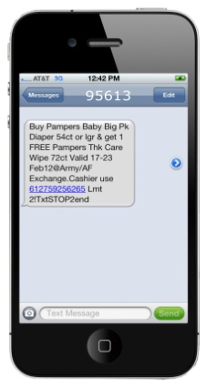



Your Exchange Benefits in Retirement
“We’re honored to serve those who have served. ”
Savings and special offers are right at your fingertips-shopmyexchange.com
Online
Sign up for alerts and discounts
On Your Phone
And at your local Exchange and Express!
Get great money saving offers!
Tri-weekly coupons by text
Name brand discounts (10%+)
Weekly Facebook discounts (https://www.facebook.com/shopmyexchange)
eNewsletter online discounts
Buddy list specials/local events
Notes:
We’ve improved our online information for our Retired Military family. Go to shopmyexchange.com and click on “Community”. You’ll find a wealth of information on the military community and resources specific to Retired Soldiers. There’s even a Retiree Corner link that will take you to a collection of memorabilia and items that are of interest to Retired Soldiers.
Online - Facebook – We feature coupons that you can use in-store or online. For use in-store, just print out the coupon from the Facebook AAFES BX/PX “coupons” tab on the left side of the page. To use a coupon online, enter the coupon code during the checkout process. To get to our Facebook page, just type www.facebook.com/AAFES.BX.PX.
Each year, the Exchange salutes your service with a special three-day event.
Benefits information flyer will be direct mailed to approximately 820,000 Army and Air Force Retired Soldiers in CONUS. OCONUS locations will receive flyers sent directly to their stores. The celebration will include those retired and still serving and invite them to participate in locally planned store activities and take part in exceptional sales events to celebrate those who have served and are still!
Save 5 cents off every gallon at Express Fuel Stations when you pay with your MILITARY STAR card. Available every day, 365 days a year. Periodic fuel promotions allow you to save more than 5 cents per gallon. Previous promotions were 10 cents off per gallon or more.
Our customers are mobile, and so are we! Download the Exchange app on your mobile device for instant access to Exchange information.
Get Gift Card Balances
Find Exchange Store Locations
Shop the mobile Exchange
Access Community Information such as
Public Affairs, Vendor Relations and More.

Slide 66

Retired Soldier Motto:
“Your mission has changed, but your duty has not”
Opportunities to Still Serve include:
    JROTC Instructor
    Installation volunteer positions
    Military service organizations
    Veterans service organizations
    Talk to your retirement services officer about joining
    Installation Retiree Councils
    CSA Retired Soldier Council
Recent Council reports available at:
https://soldierforlife.army.mil/retirement/csa-retired-soldier-council
Notes:
Many Retired Soldiers continue to LIVE the Army retiree motto --“Once a Soldier, always a Soldier…a Soldier for Life”
If interested in learning of ways to continue serving, contact your nearest installation Retirement Services Officer (RSO). Perhaps service on their installation Retiree Council appeals to you. We mentioned this at the beginning of the seminar when we were talking about what we do. We’d like you to consider it now in light of what you might like to do after retirement.
One of the duties of an installation Retiree Council is to formulate issues annually to “send up” to the Chief of Staff, Army Retired Soldier Council for their deliberation and possible briefing to the Chief.
The 14-member CSA Retired Soldier Council serves Retired Soldiers worldwide, and is comprised of seven officers and seven enlisted members. They serve at the approval of the CSA for 4-year terms.

Slide 67
Retired Soldier Mission: To Hire and Inspire
To Hire
    Hire Veterans if you can
    Refer Veterans to jobs you know of
    Refer job openings to the closest
    American Job Center run by the
    Department of Labor
    To Inspire
    Talk to young people about joining the military
    Tell your Army story!
    Connect the 99% who don’t serve with the 1% who do; correct the misperceptions about the military!
Notes:
Many Retired Soldiers continue to LIVE the Army retiree motto --“Once a Soldier, always a Soldier…a Soldier for Life”
If interested in learning of ways to continue serving, contact your nearest installation Retirement Services Officer (RSO). Perhaps service on their installation Retiree Council appeals to you. We mentioned this at the beginning of the seminar when we were talking about what we do. We’d like you to consider it now in light of what you might like to do after retirement.
One of the duties of an installation Retiree Council is to formulate issues annually to “send up” to the Chief of Staff, Army Retired Soldier Council for their deliberation and possible briefing to the Chief.
The 14-member CSA Retired Soldier Council serves Retired Soldiers worldwide, and is comprised of seven officers and seven enlisted members. They serve at the approval of the CSA for 4-year terms.

Slide 68
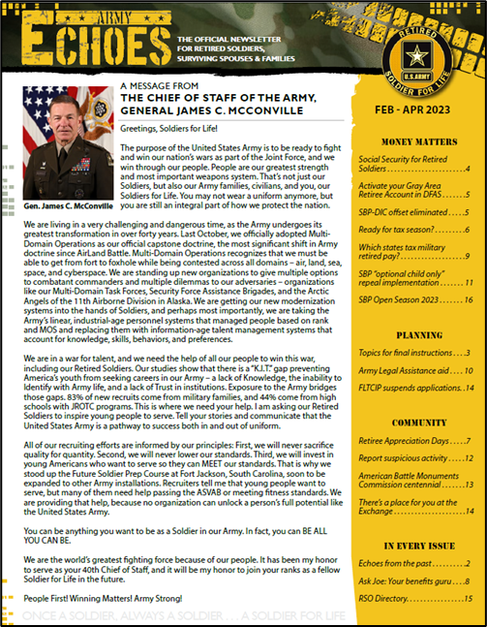

Army Echoes
The Army’s official newsletter for
Retired Soldiers
Delivered electronically to your
email address in myPay
Change your email address in myPay
to a commercial email address before
you retire!
iPhone & Android phone apps
Read the Army Echoes Blog to receive frequent news between
editions at https://soldierforlife.army.mil/retirement/blog
Notes:
Self-explanatory.

Slide 69



How will they know you? Conversation starters
Soldier for Life
Window Sticker
(DA Label 180 &
DA Label 180-1)
Identify yourself as a
Soldier for Life
US Army Retired
Lapel Button

Slide 70
For more information
Army
https://soldierforlife.army.mil/Retirement
Air Force
https://www.retirees.af.mil/
Navy
https://www.mynavyhr.navy.mil/Career-Management/Retirement/
Marine Corps
https://www.manpower.usmc.mil/webcenter/portal/MRAHome
Coast Guard
https://www.dcms.uscg.mil/ppc/ras/

Slide 71
Where Do You Find Retirement Information?
Army G-1 Retirement Services Office Homepage https://soldierforlife.army.mil/Retirement
  DA Retirement Planning Guide
  USAR & ARNG Non-Regular Retirement Guides
  DA Survivor Benefit Plan (SBP) Briefing
MyArmyBenefits at https://myarmybenefits.us.army.mil/
Army Installation Retirement Services Officers (RSOs)
https://soldierforlife.army.mil/Retirement/contact-us
HRC Gray Area Retirements Branch https://www.hrc.army.mil/content/Gray%20Area%20Retirements%20Branch
USAR Readiness Division RSOs listed at: https://soldierforlife.army.mil/Retirement/ArmyReserve
State RSOs can assist National Guard Soldiers
https://myarmybenefits.us.army.mil/Benefit-Library/Resource-Locator
SBP vs. Life Insurance Comparison tool
https://actuary.defense.gov/Survivor-Benefit-Plans/

Slide 72








https://soldierforlife.army.mil/Retirement
https://www.dvidshub.net/unit/HQDA-RSO
@USArmySoldierForLife
@USArmySoldierForLife
@USArmySFL
@USArmySFL
@USArmySFL
@USArmySFL
https://soldierforlife.army.mil/Retirement/change-of-mission
https://soldierforlife.army.mil/Retirement/army-echoes https://soldierforlife.army.mil/Retirement/blog
Join the conversation

Slide 73

Thank you for your service!!
QUESTIONS?

